Slide 1
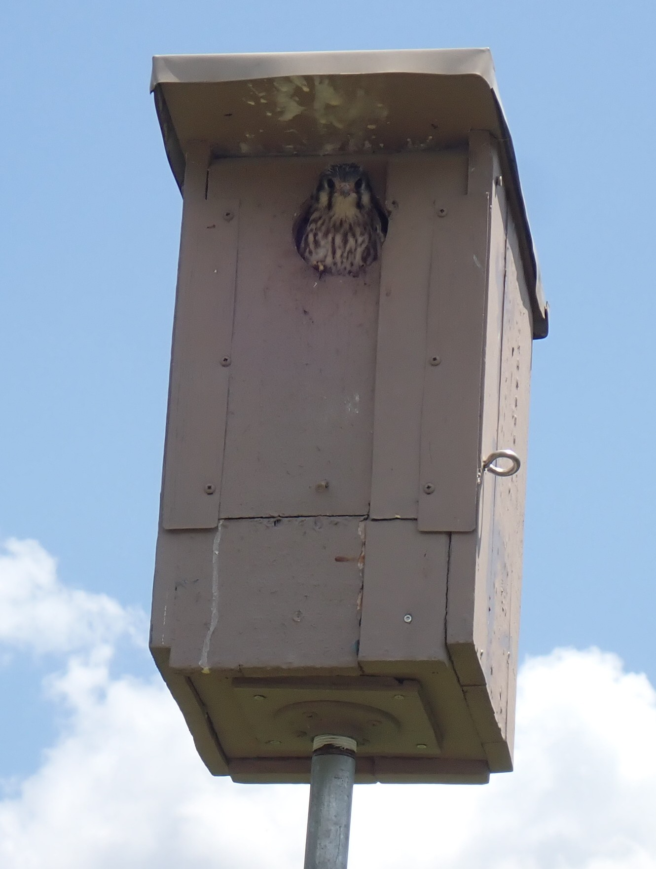
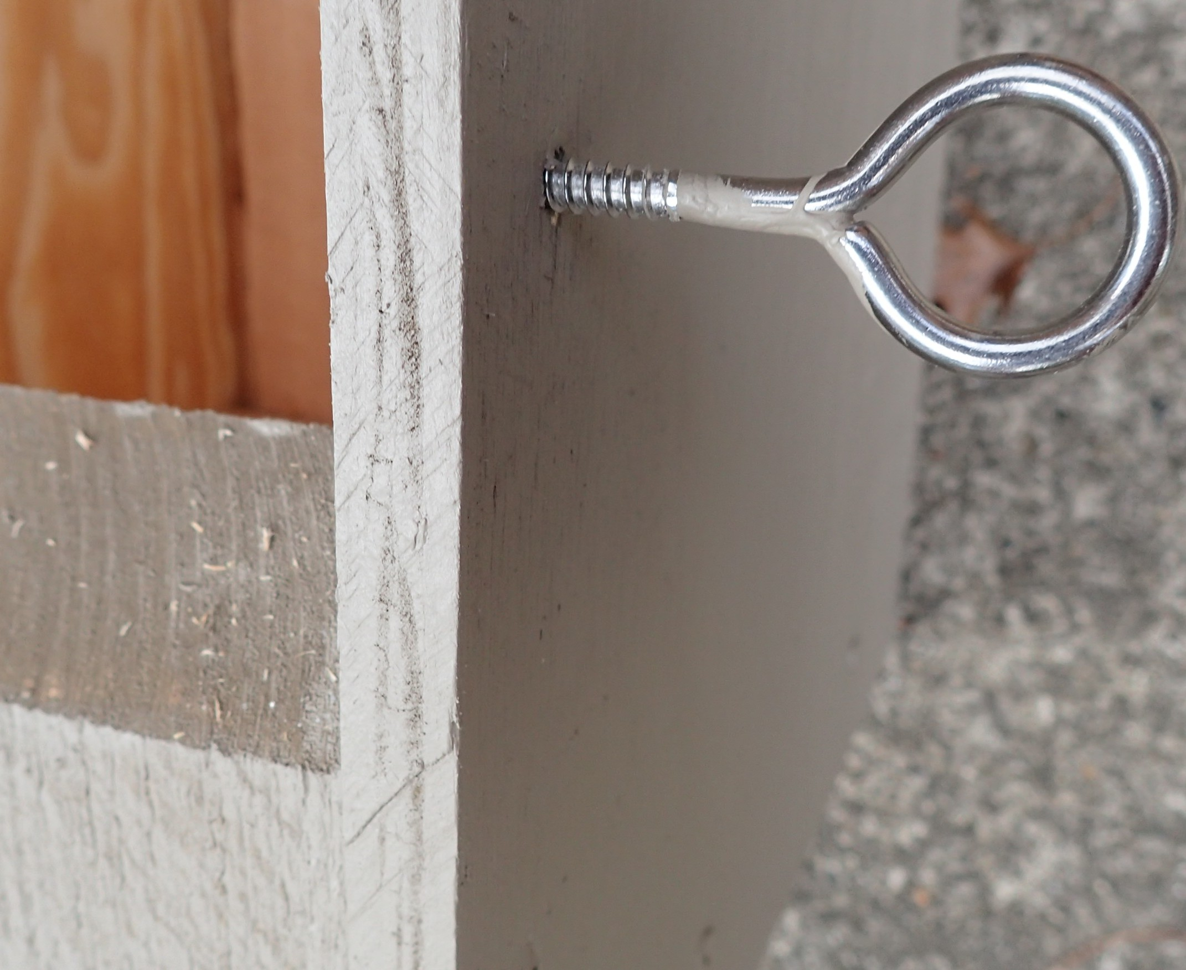
Note this box has a backward sloping aluminum roof with drip lines all around, is front opening with a stainless steel eye screw on the right side that can be unscrewed by hand to swing open the front door (see below). The bottom 1” galvanized pipe mount screws into a floor flange centered on the box bottom so the box is more stable in heavy winds.

Slide 2
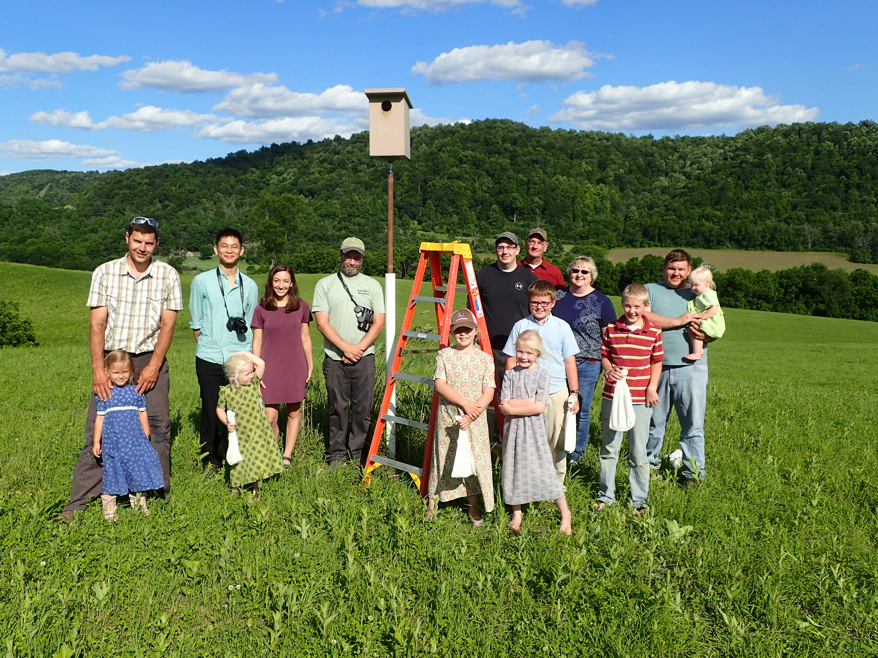
There are good designs for building kestrel nest boxes that can be found on the internet or in books. In this presentation we’ll describe and explain designs we use.
The box at left is mounted on a 1” galvanized pipe, 5’ long, telescoping from a 1.25” pipe, 10’ long, sunk in the ground 2’ with 30 lbs. of concrete at the hole bottom. When lowered the box is 8’ high: accessible with a 6’ fiberglass stepladder. Fiberglass is preferred since many of our boxes are along electrified fences. A white plastic sleeve on the pipe bottom increases visibility to farmers cutting the hayfield.

Slide 3
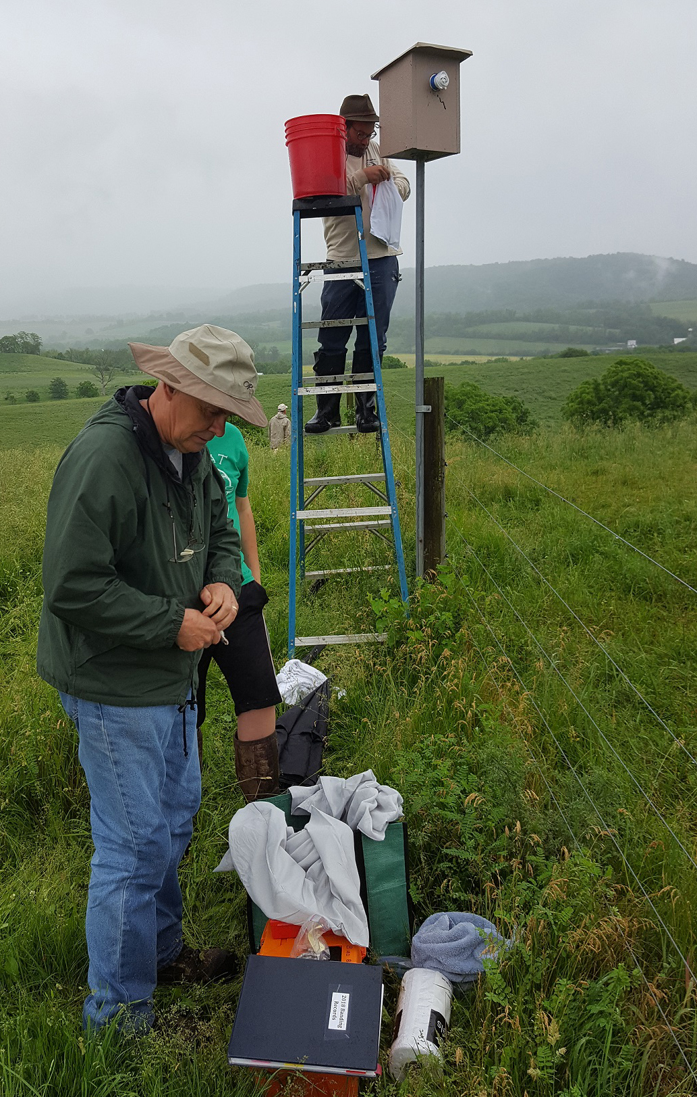
8’ high fiberglass stepladder being used to remove kestrel young for banding. Box is back opening. Front hole has been blocked. Telescoping pipe mount is clamped to fenceline post but pipe is also anchored in concrete at the bottom of an 18” deep hole. Drill a 3/16” hole at ground level in the pipe so water entering the pipe can drain out. With no outlet the pipe can fill with water, freeze, and split in the winter.

Slide 4
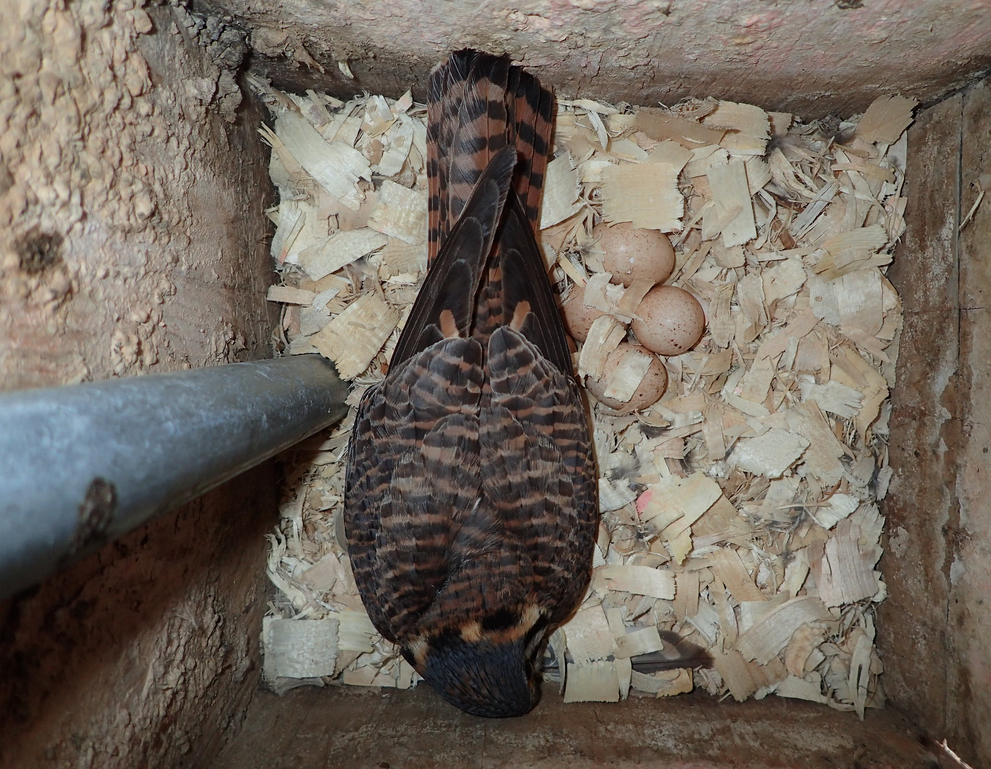
A less expensive alternative to the center floor flange plumbing pipe mount is the interior back mount using a 10’ long 1” galvanized electrical conduit tube. A 1-1/8” paddle bit hole at the box bottom (wobble the bit to get a 1/32” wider hole so the pipe fits) and a stainless or galvanized bolt at the top secures the mount to the box. This alternative limits the box height to a fixed height of 10’ but eliminates the need for a drain hole at ground level.

Slide 5
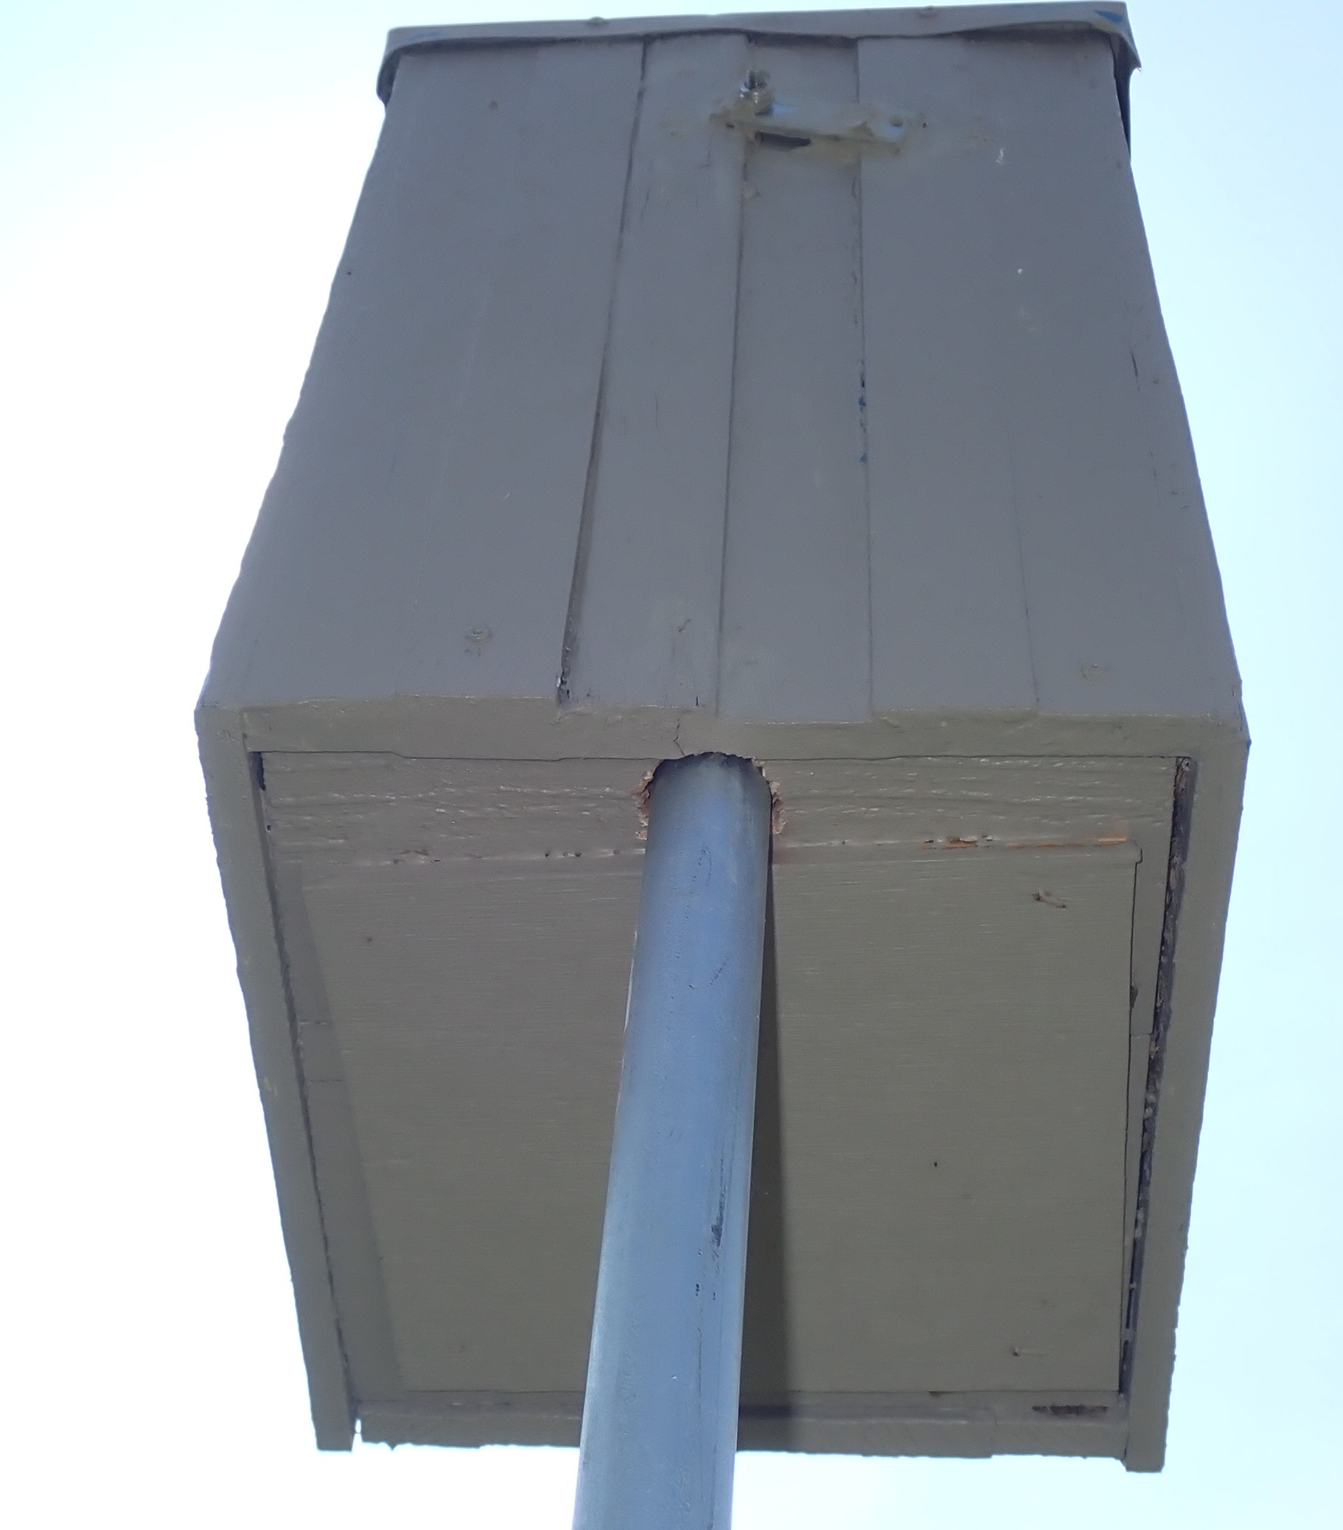
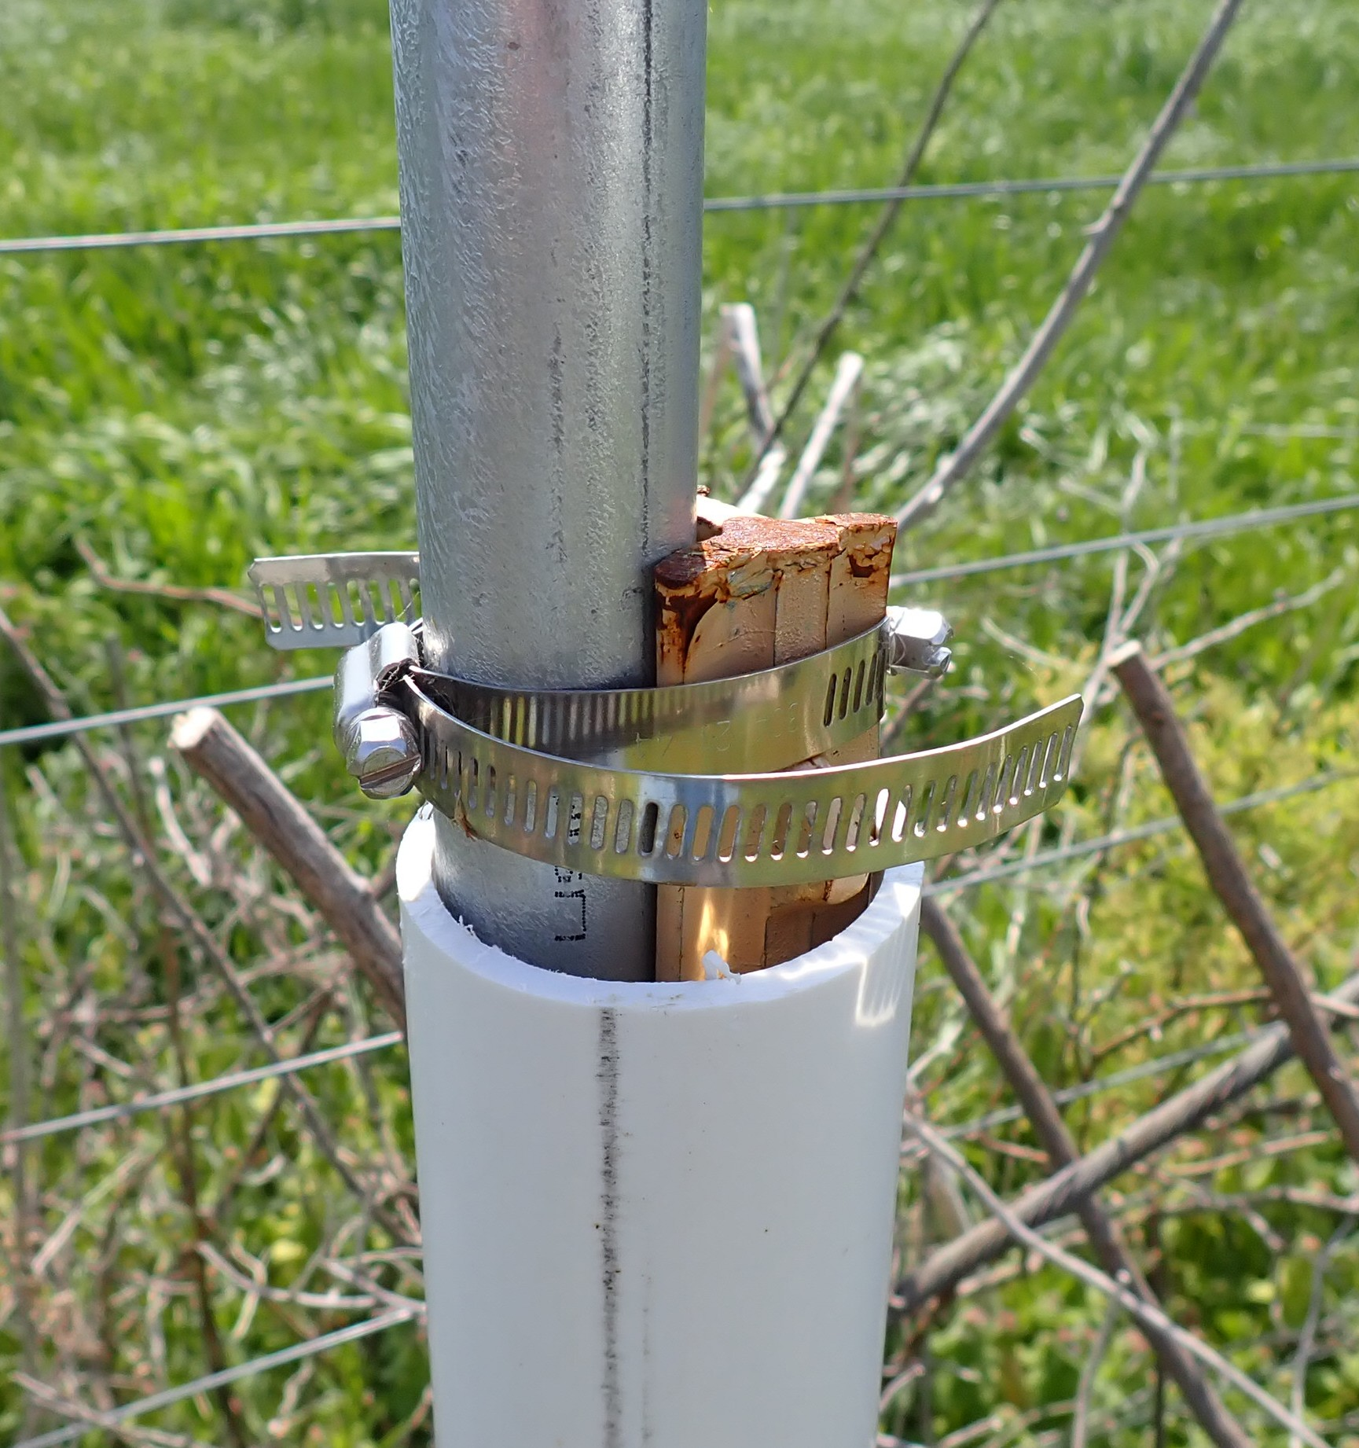
At left is view of electrical tube interior mount. Use a piece of steel or wood or a wide washer at the top bolt location since this mount system puts a lot of stress along the wood grain, which can cause the box back to split. Below is a view of the tube hose clamped to a 6’ studded 1.25 lb. T-post with a 2” PVC pipe wrapping the bottom 3.3’.

Slide 6
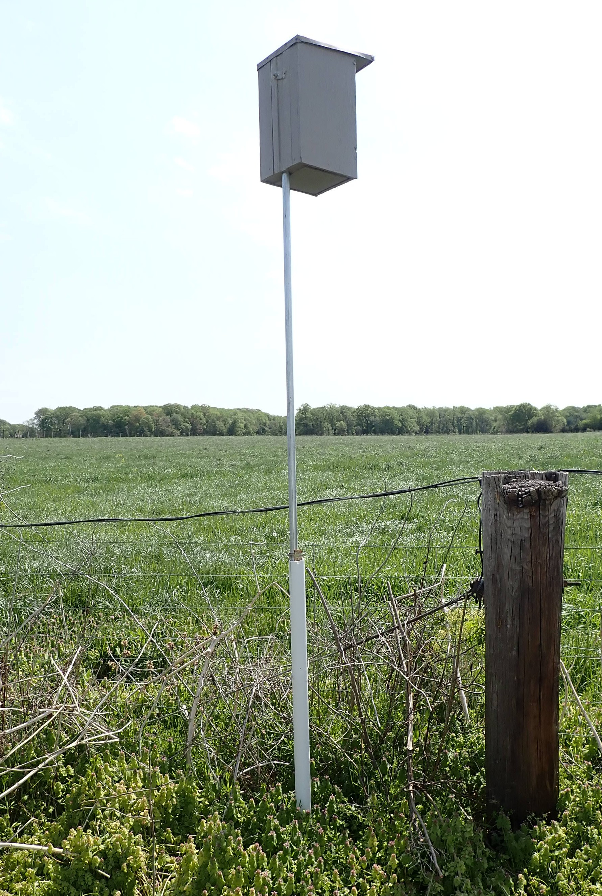
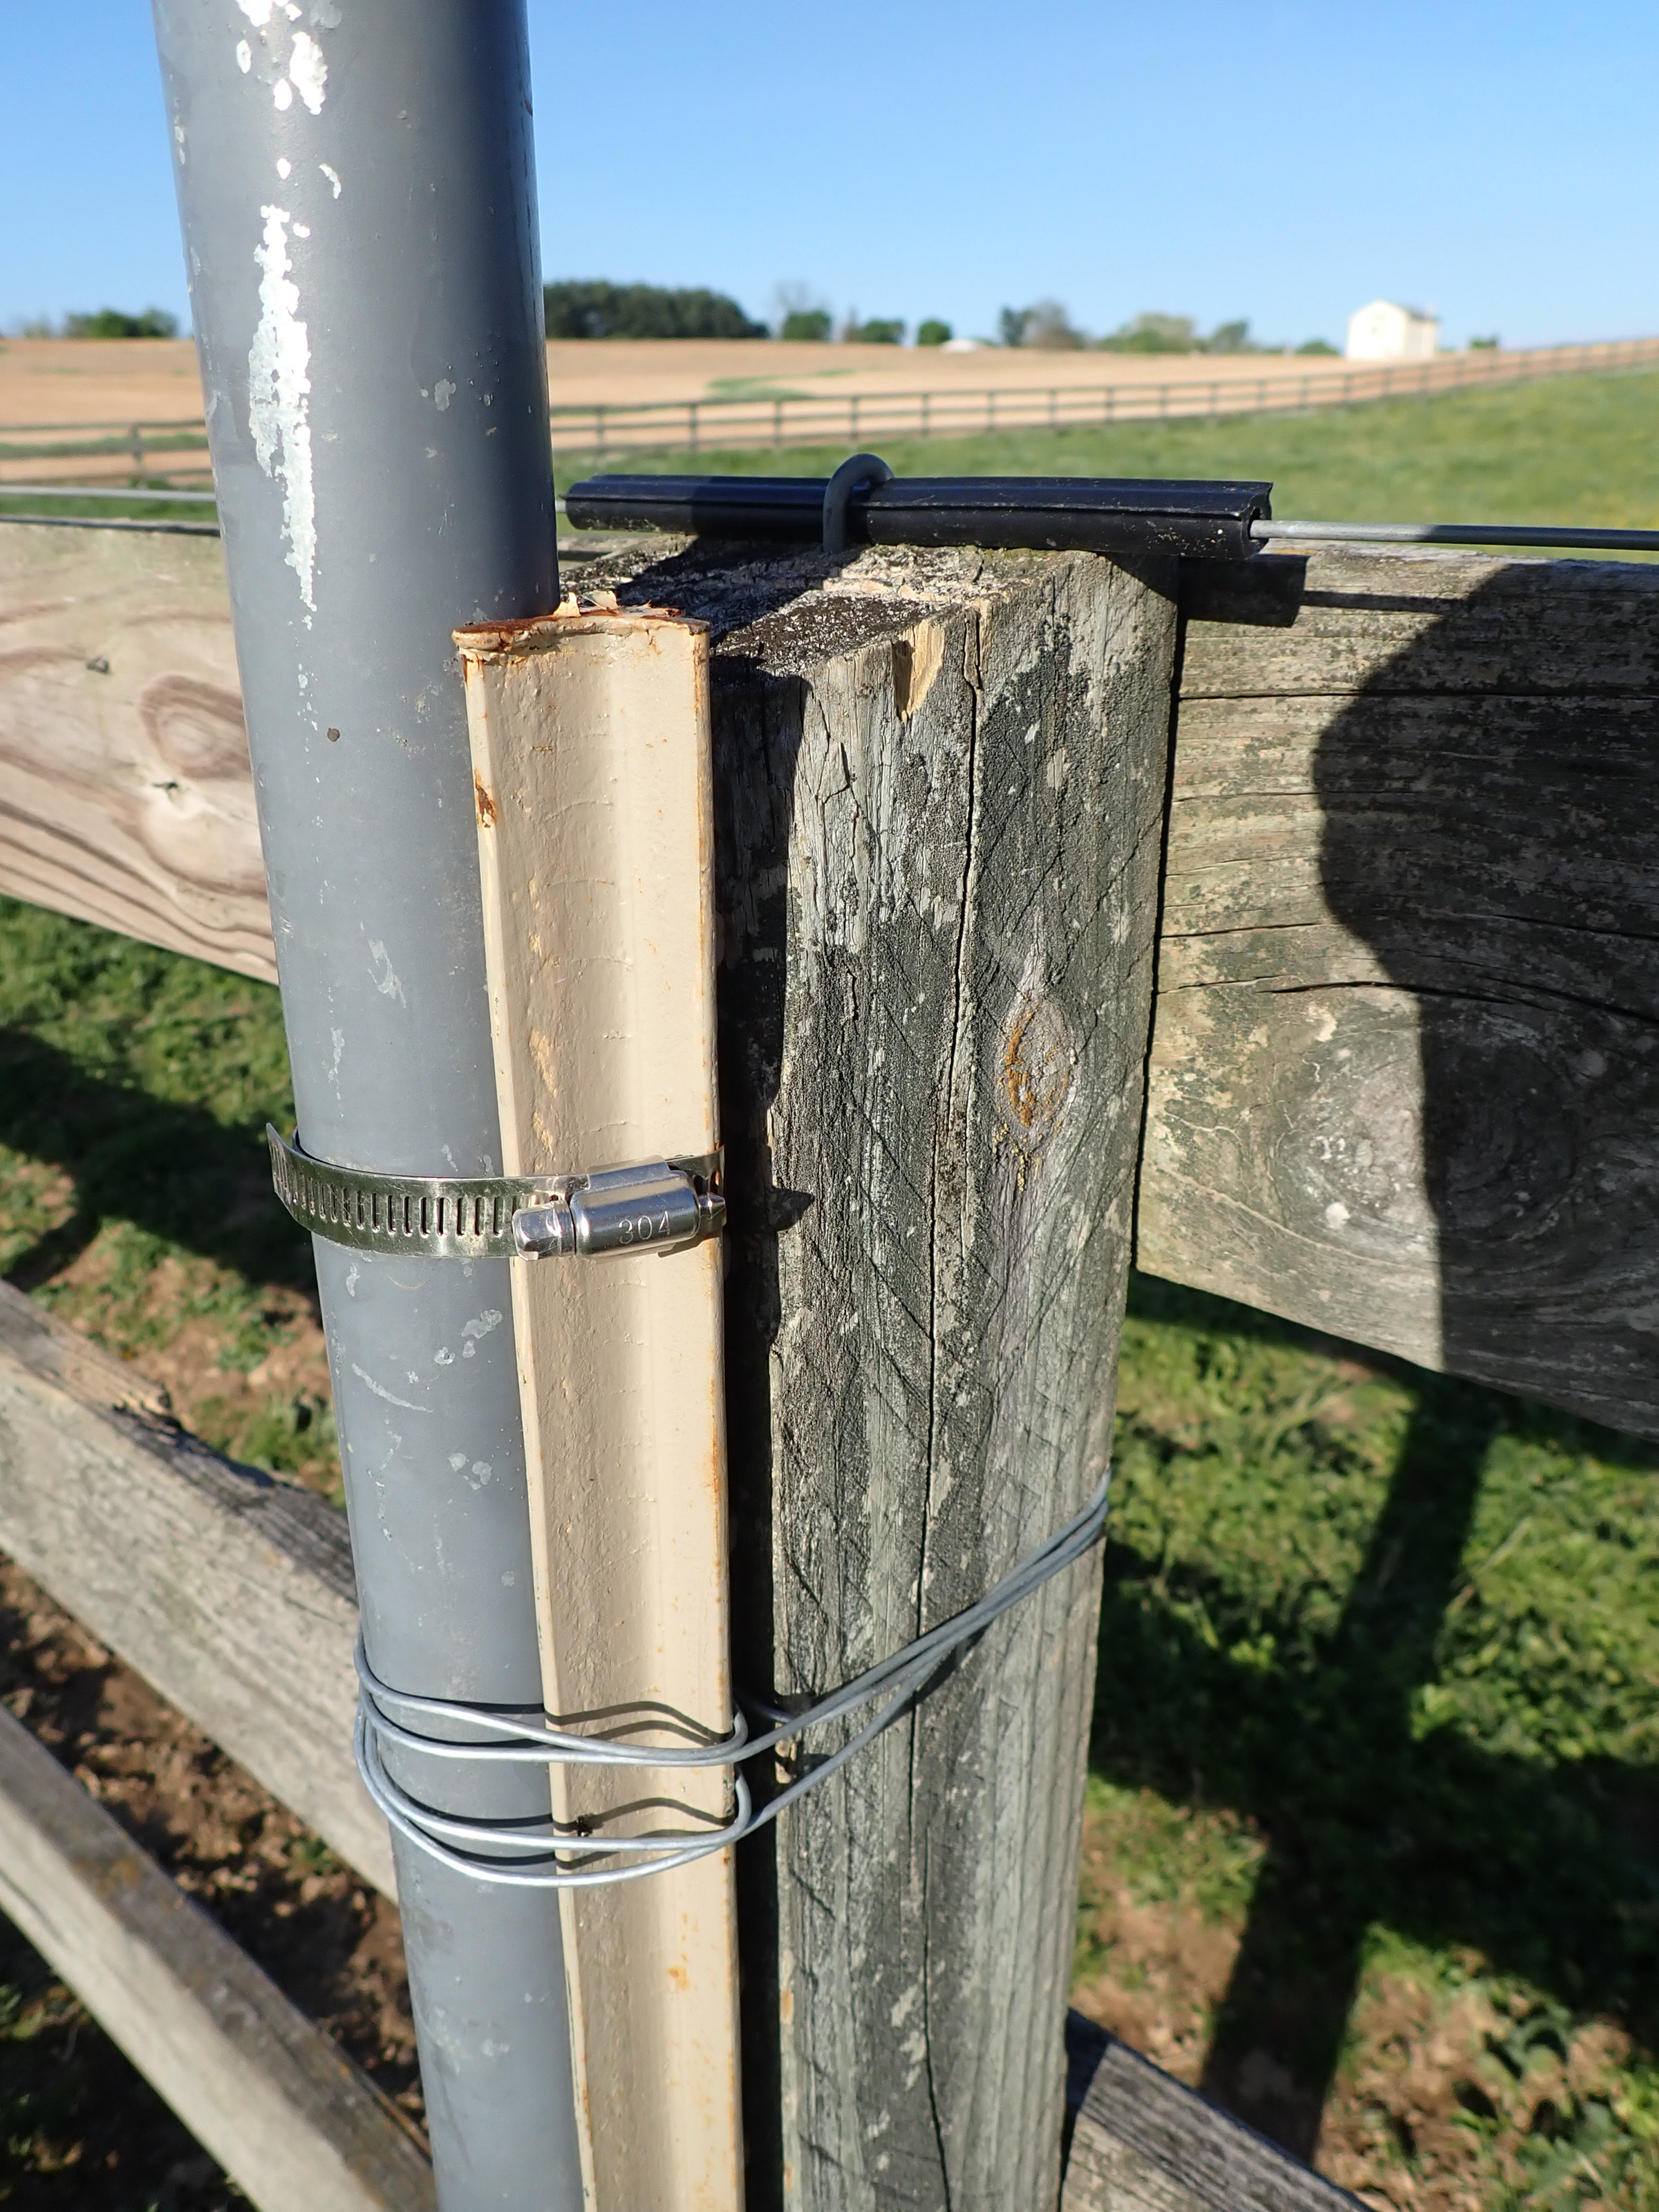
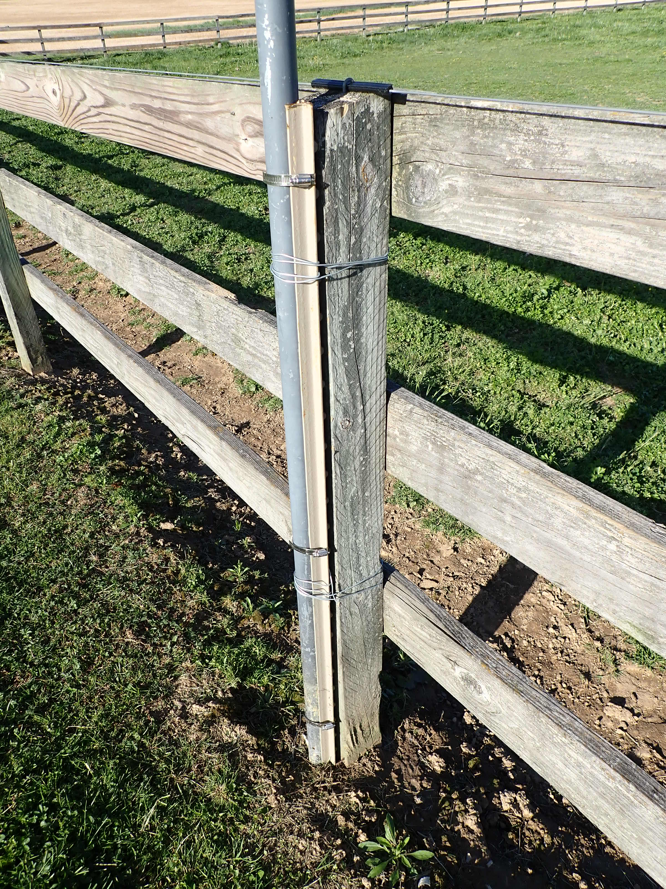
Final product is shown at left. A 2nd hose clamp is typically installed at the post bottom. This mount can be clamped to an existing fence post for additional stability and less box sway. The post pounder (we use a 32 lb. unit) must be turned upside down when affixing to existing posts. Use a level to check plumb and clamp or wrap the T-post and conduit to the existing fence post (see below wire wrap design). We use multiple strands of 12-gauge galvanized wire. 6’ T-posts are pounded in 2’ deep. Pounding T or U-Channel posts is easier and cheaper than sinking pipes in concrete but not as stable for higher box mounts.

Slide 7
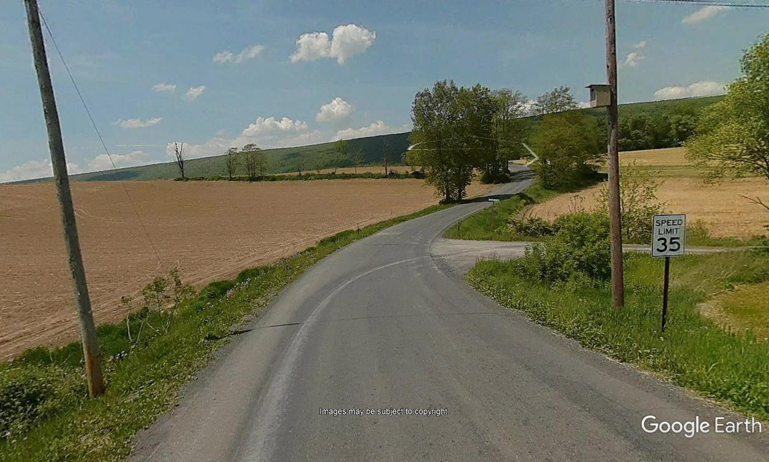
This utility pole mounted box faces across a country road. It was subsequently replaced with a back opening box that was relocated to the pole on the left so it faced away from the road. This photo is a download from Google Earth street view.

Slide 8
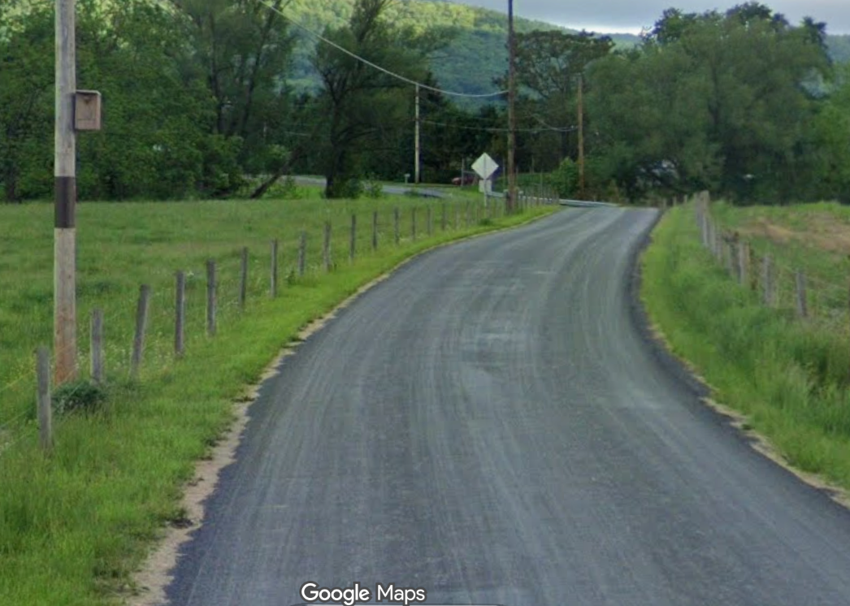
Although Google Earth provides good street views, Google Maps has more extensive street view coverage. This photo shows a 24” aluminum predator guard under a box. This box has since been repositioned so it faces away from road.
Google street views allow you to check out the habitat of possible nest box sites without having to physically visit.

Slide 9
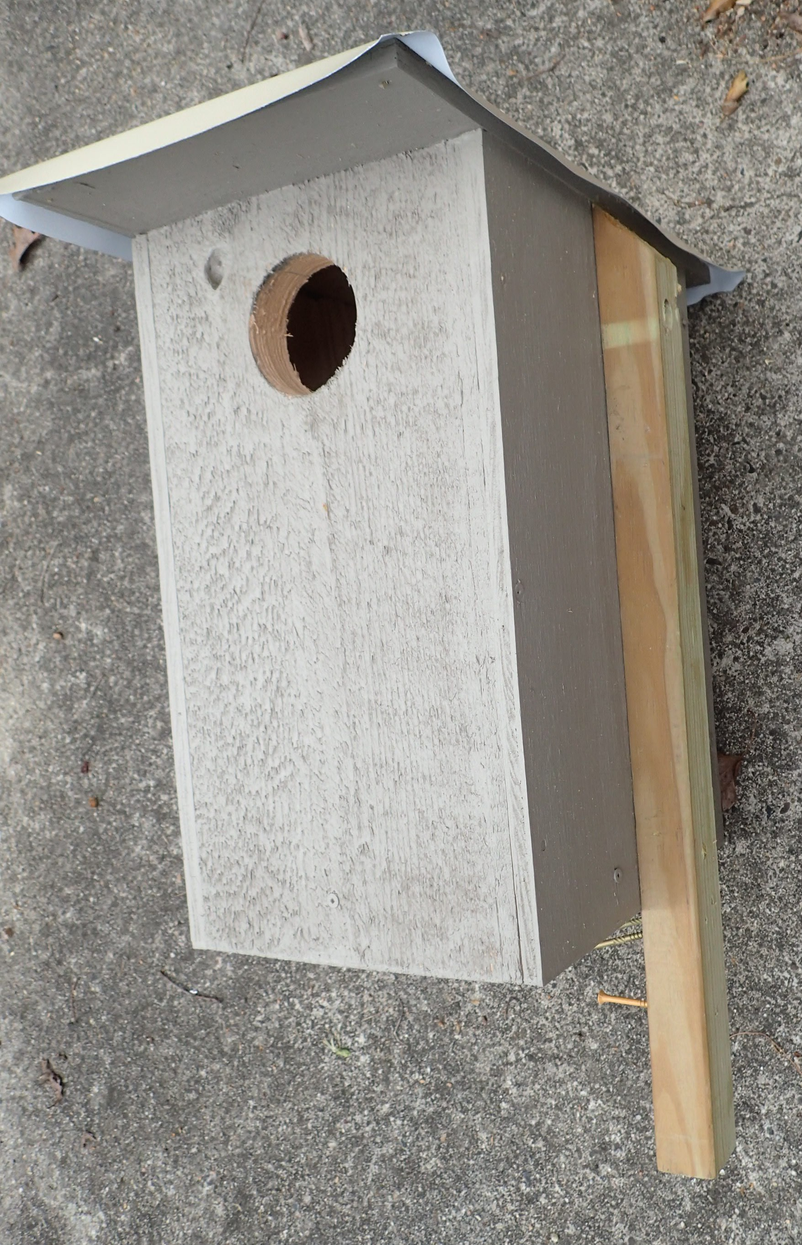
This back opening box is suitable for a utility pole or building corner, with easy right-handed access. With the aluminum on plywood top & drip edges, the roof can be either slightly back sloping or level. Height is 17”, floor is 2” thick, distance from start of hole to roof is 1.5”, and front roof overhang is 3.5”. For back opening boxes side mounts allow safer & easier access from a ladder.

Slide 10
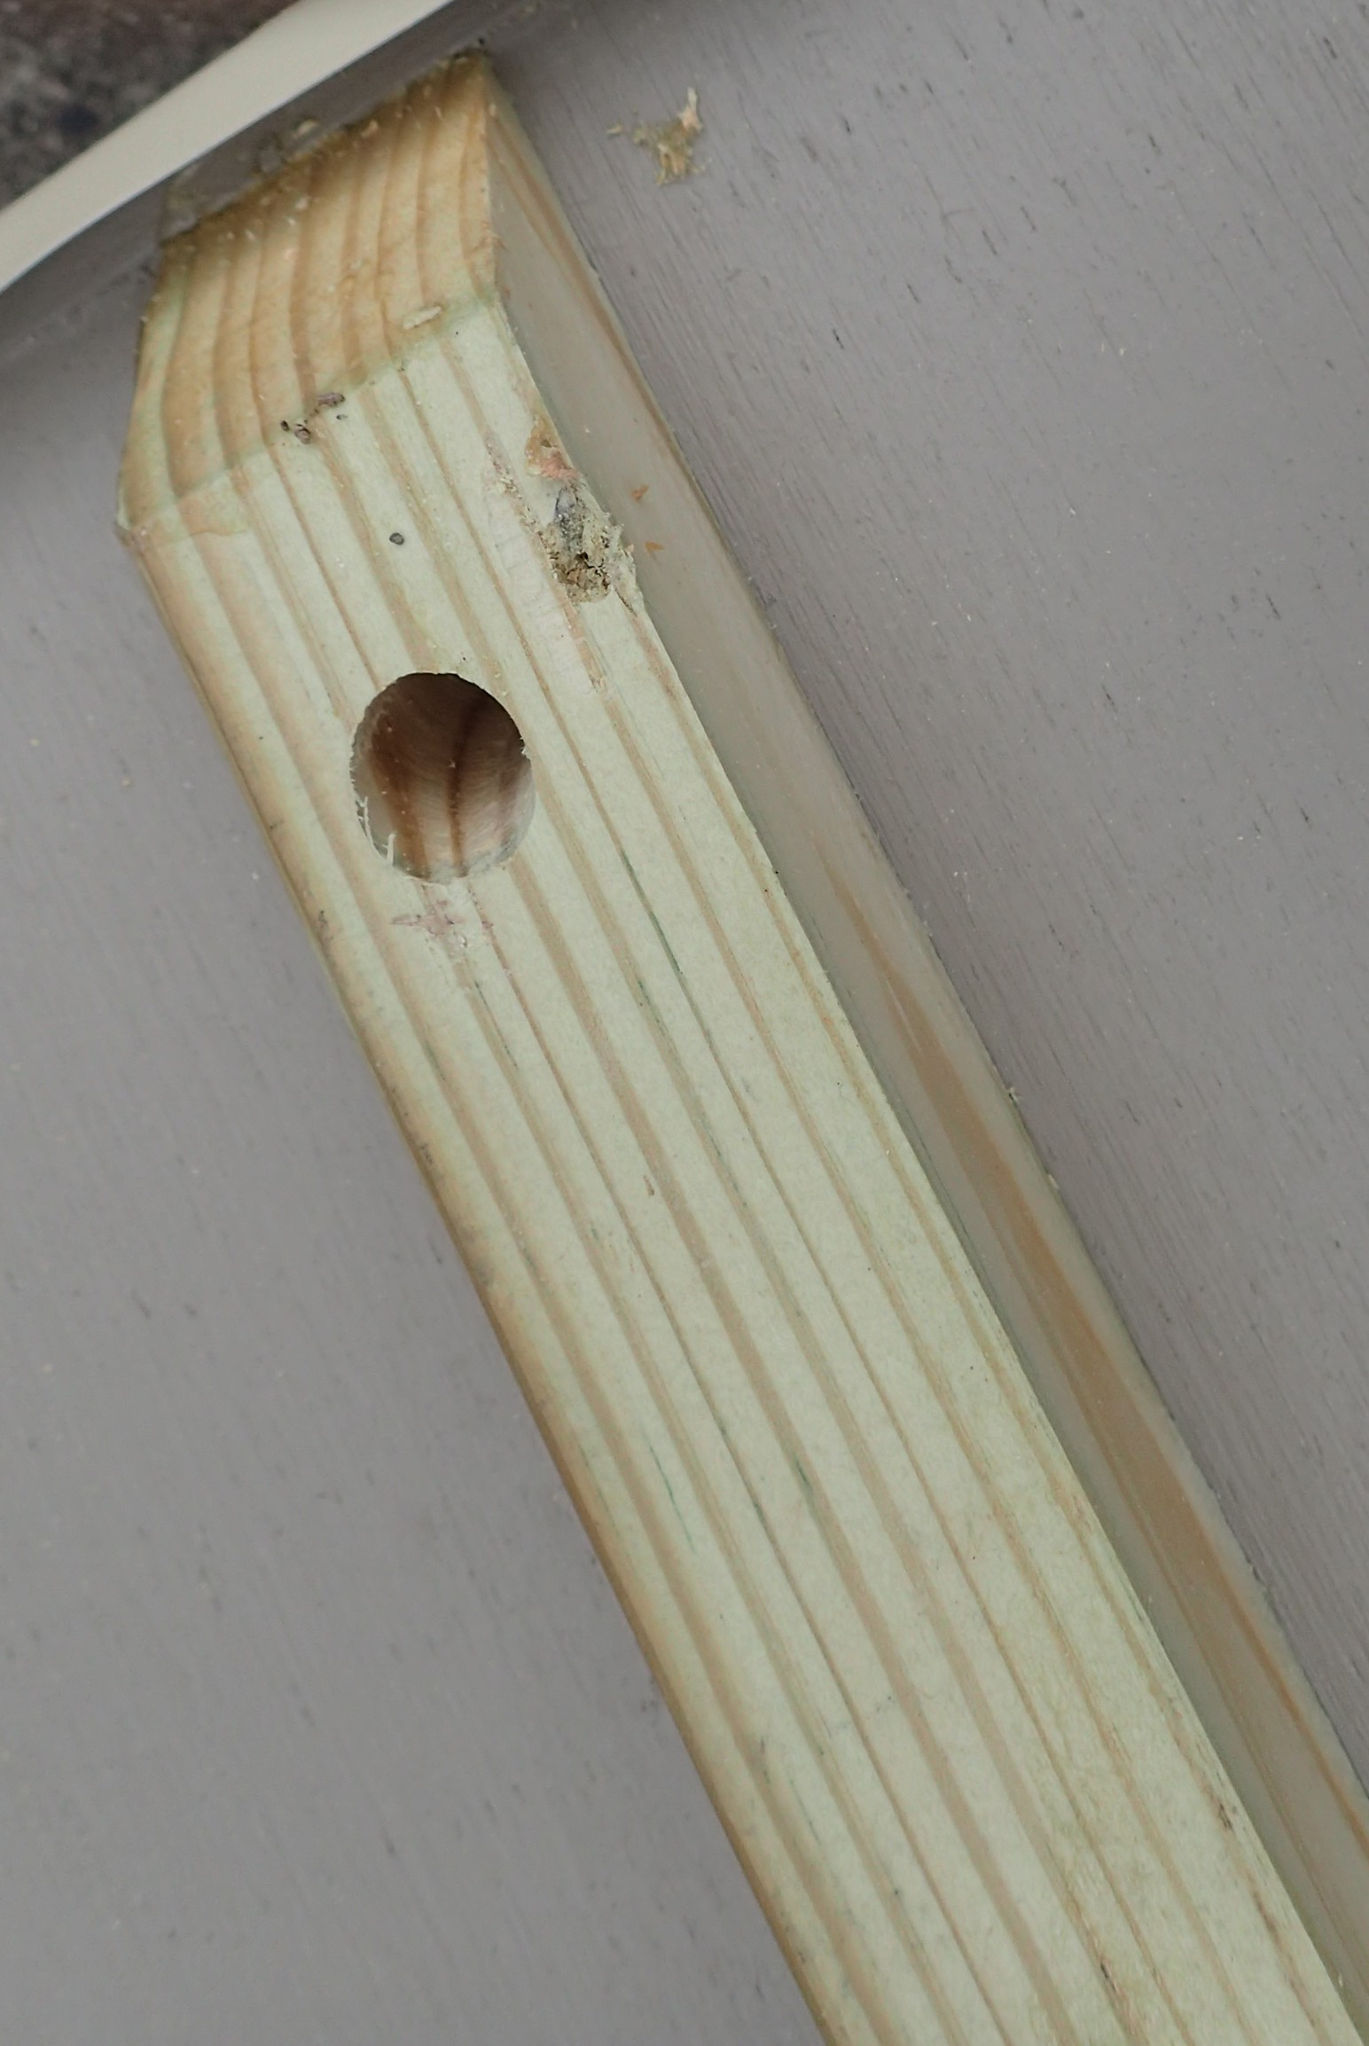
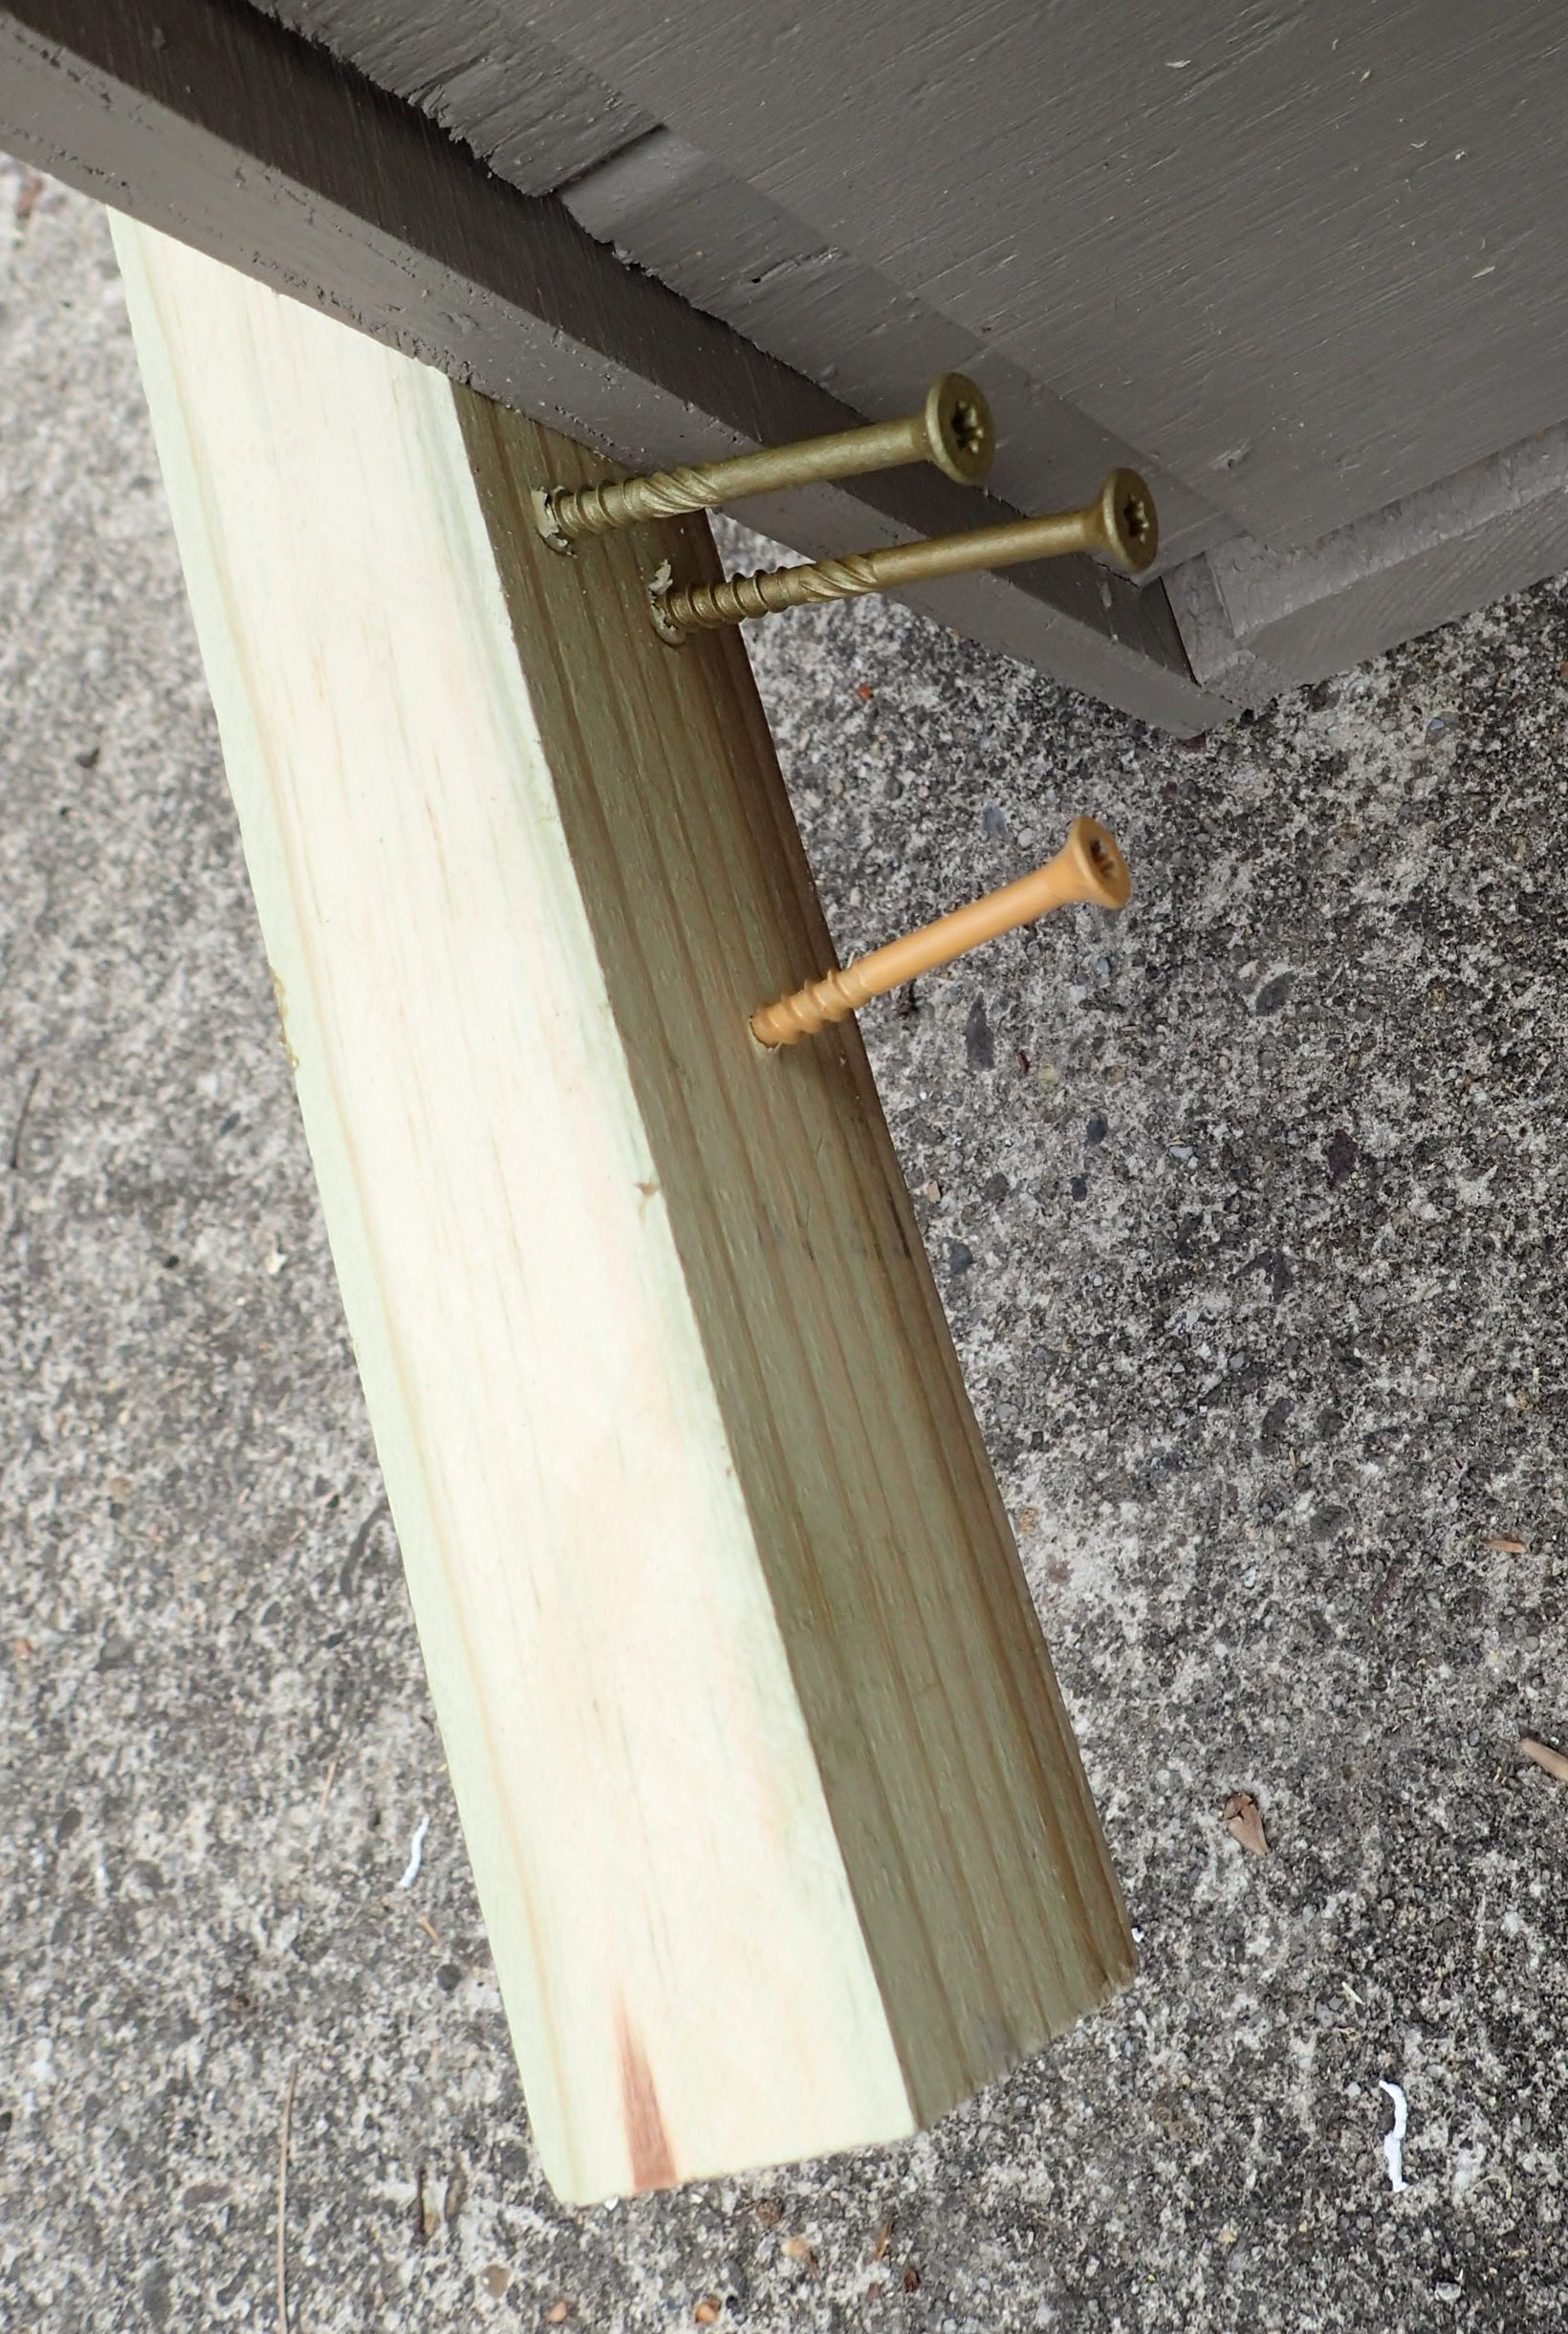
Closeup of 5/8” diameter hole drilled at 45 degree angle upward at top of mounting board. This hole allows you to first drive a 4” nail at the same angle into the utility pole so you can then hang the box before screwing in the 3 screws (3.5” long) at the bottom of this board.

Slide 11
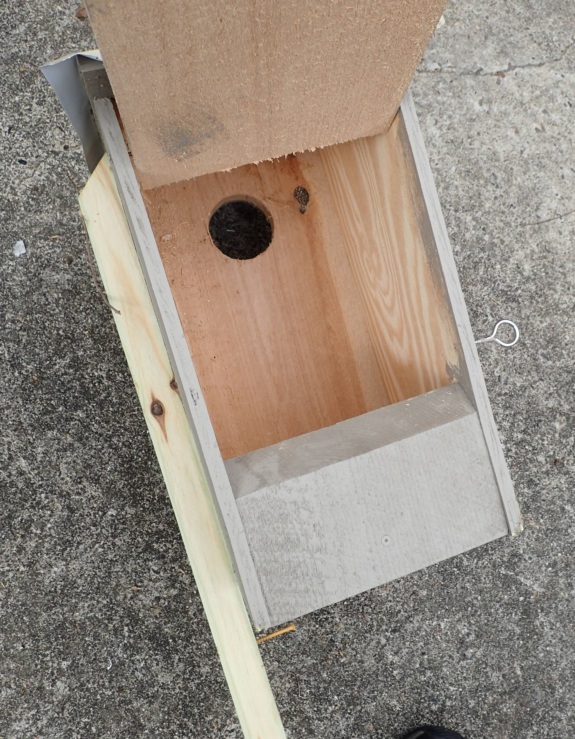
Box interior shows 45° angle at door bottom to shed rain, ½” plywood on sides, 1” cedar front and back, 1.5” floor with ½” plywood reinforcement. Good alternative materials are ¾” pine on all sides and a double layer on the bottom. Plywood is exterior-grade but not pressure-treated, which has dangerous chemicals in it. Floor areas should be between 80 and 100 square inches. The main purpose of 2” thick floors is the better insulation they provide for eggs being incubated. Thick floors also allow you to cut ¾” deep 4” wide hollows in floor bottoms.

Slide 12
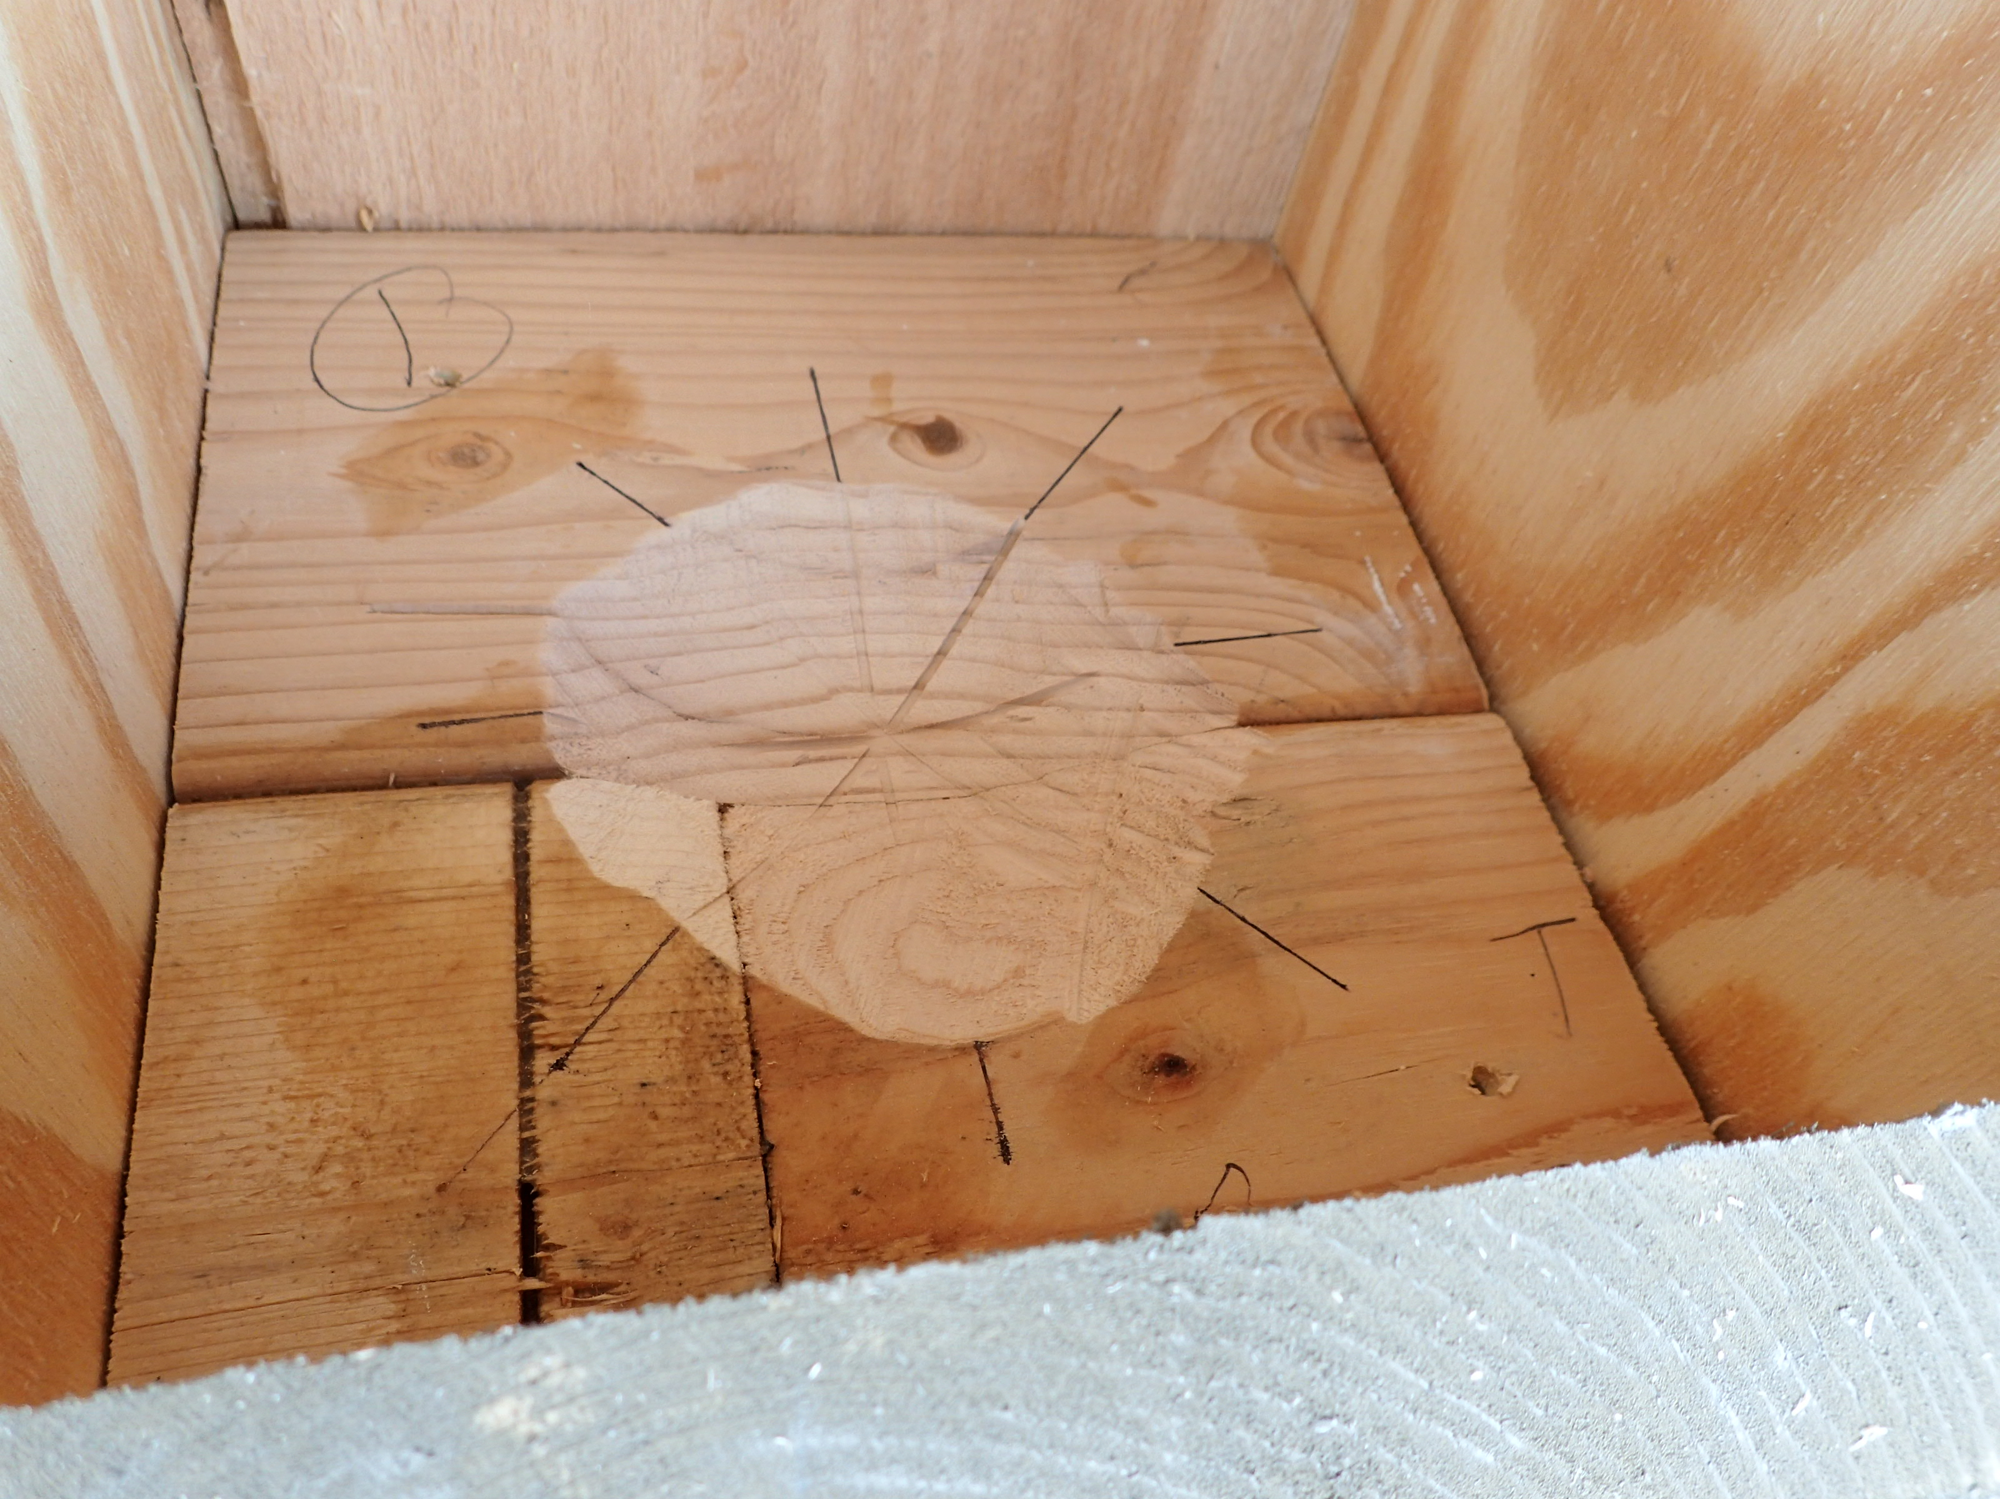
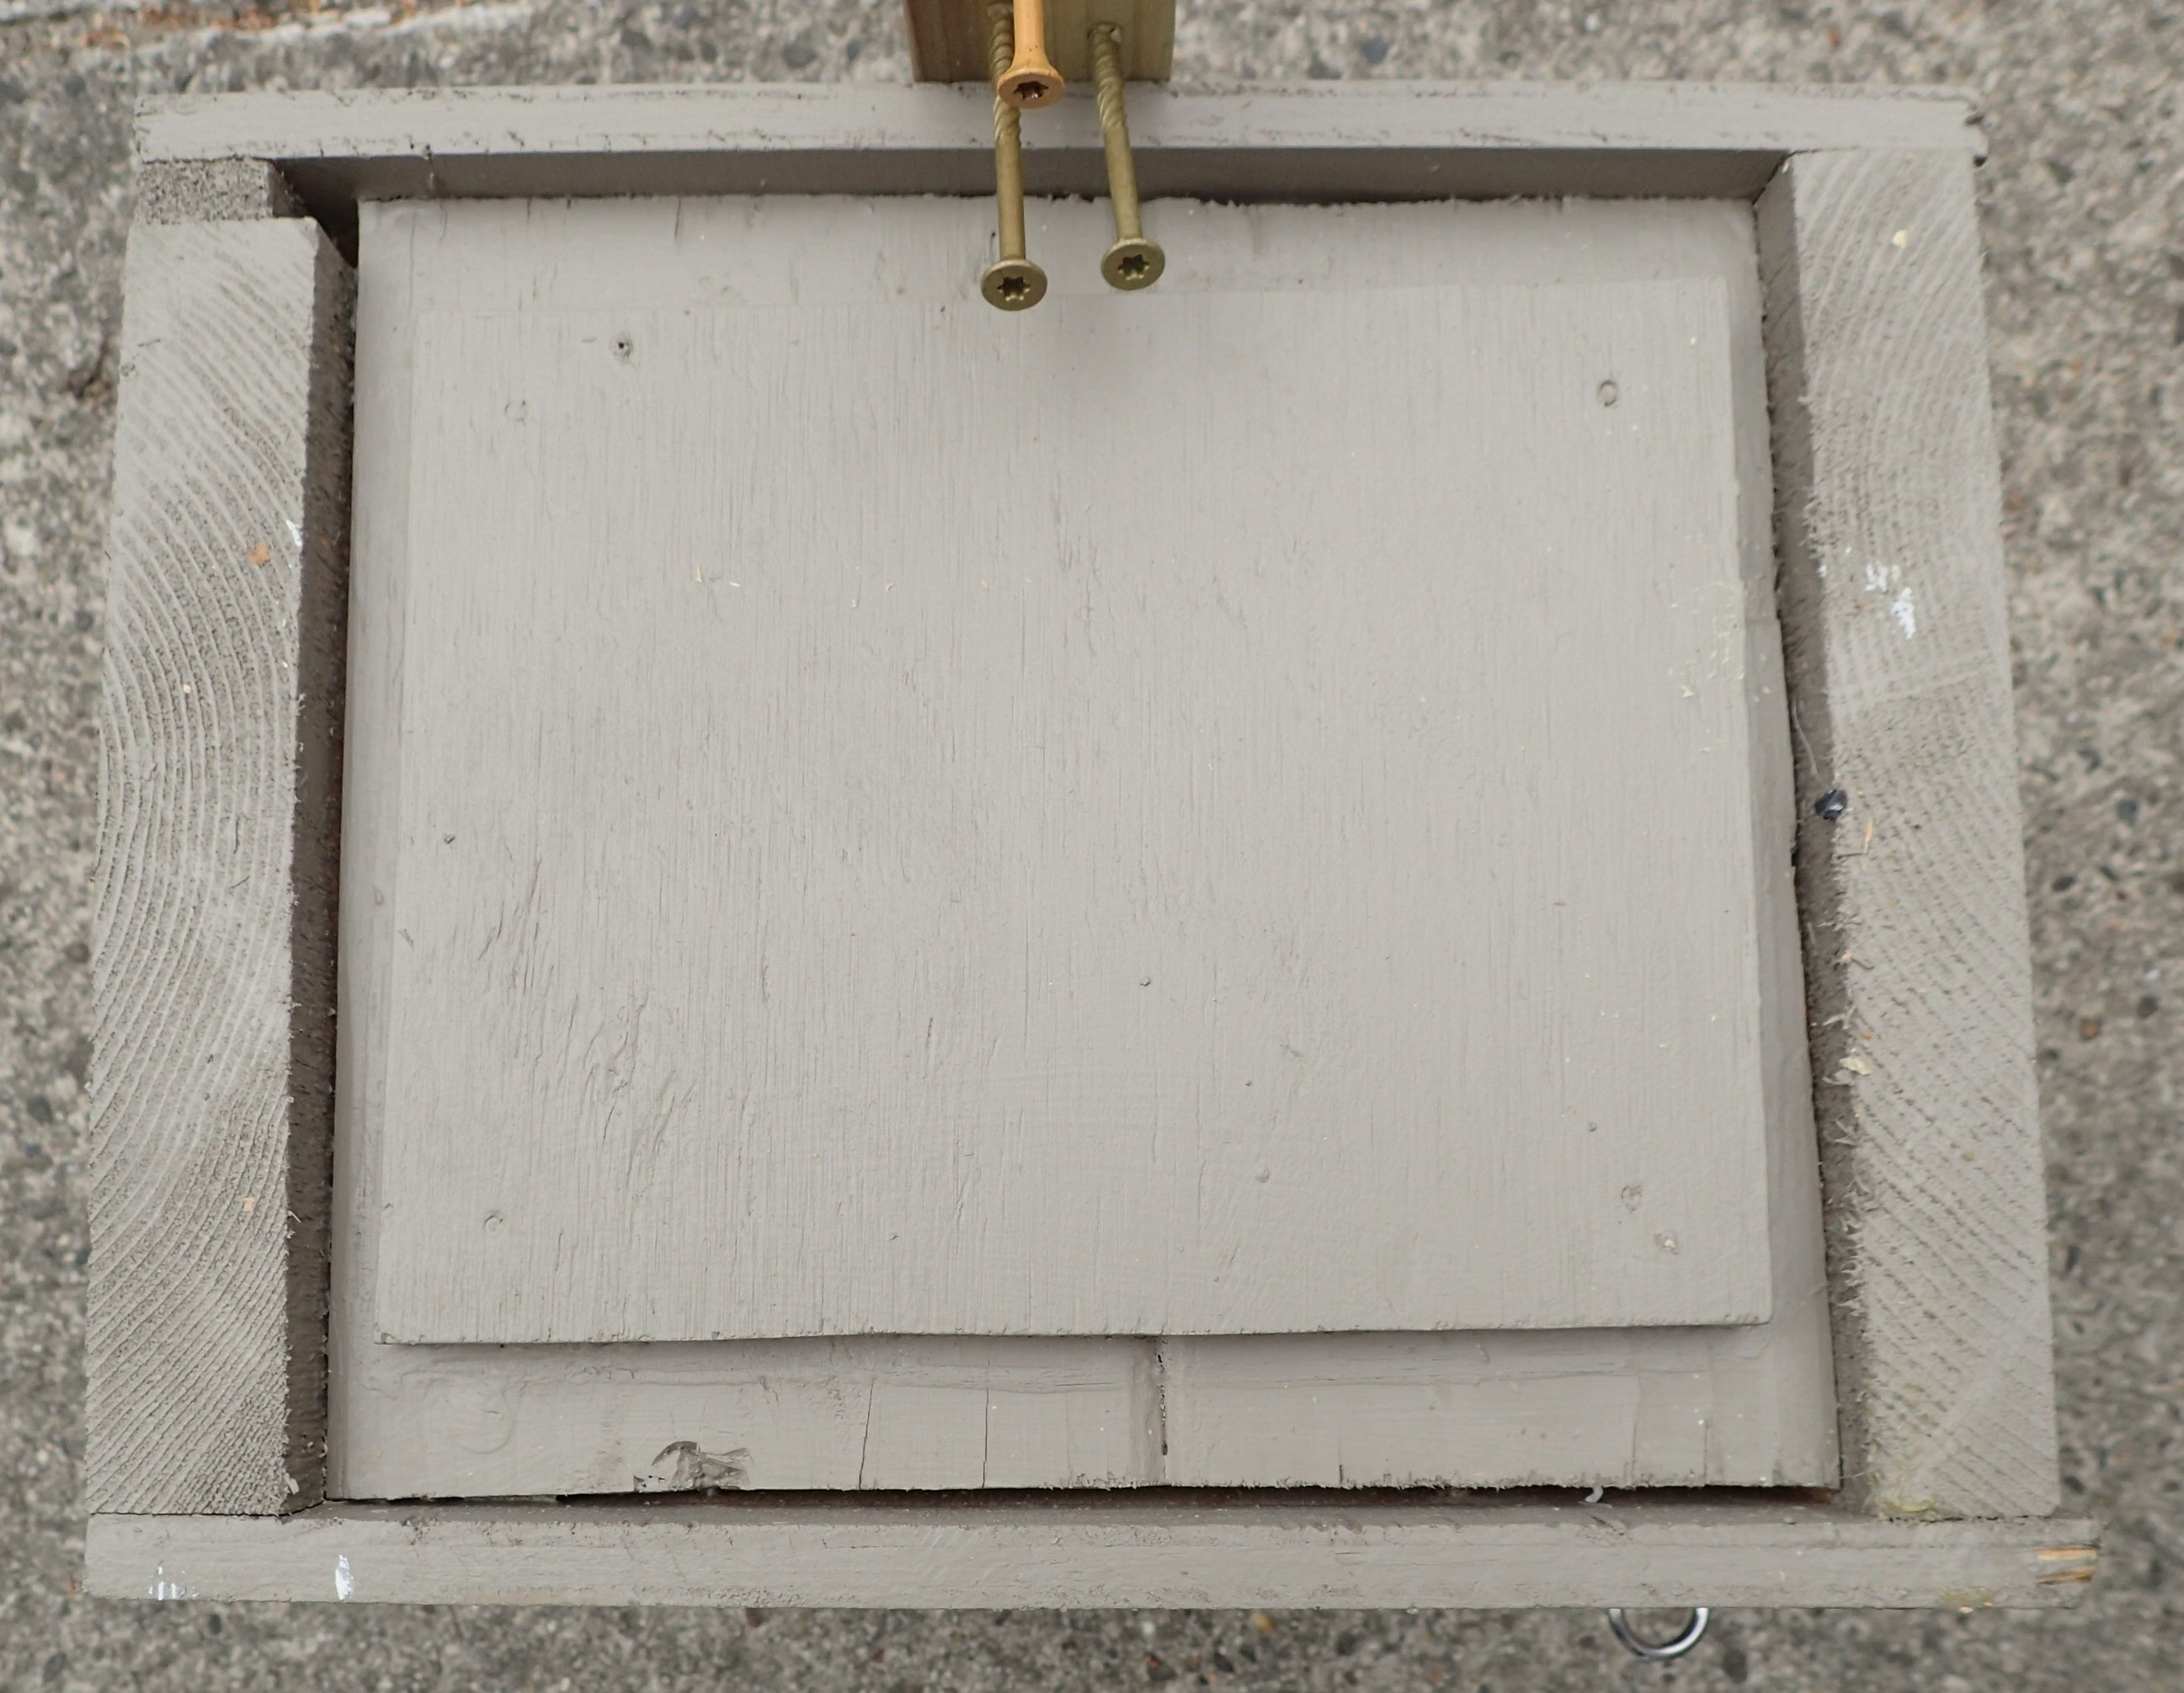
Interior floor has a 4” diameter ¾” deep depression cut in it to cradle eggs if starlings remove all shavings/chips. For safety reasons, only someone with circular saw experience should attempt to cut these concave areas. The photo on right shows a ½” exterior plywood plate glued with Titebond III glue to bottom board. We’ve had a problem with this thick floor splitting over time. This plywood plate prevents this from happening, and adds insulation.

Slide 13
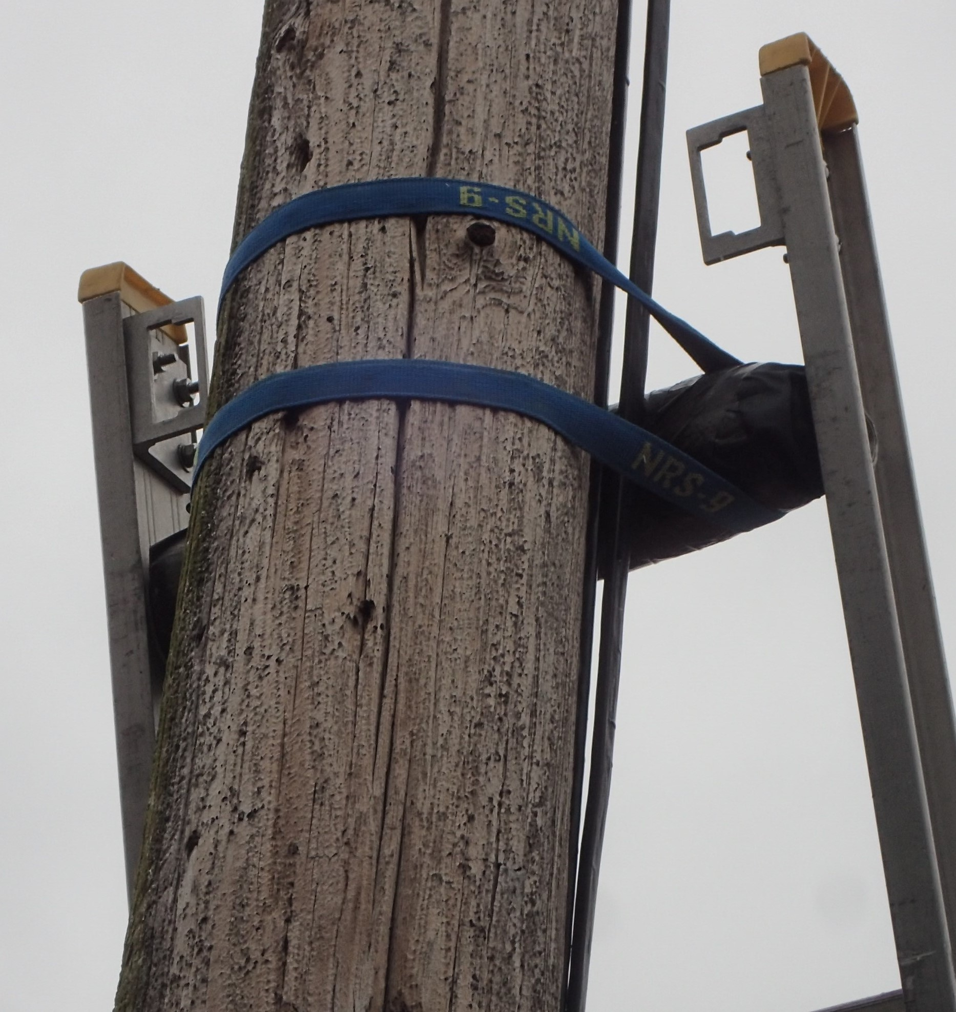
A good way to clamp a ladder to a utility pole or tree is shown in this photo. Use a cam buckle strap about 8’ long. Wrap the top rung with a foam material secured with duck tape to better lock the ladder onto the pole.

Slide 14
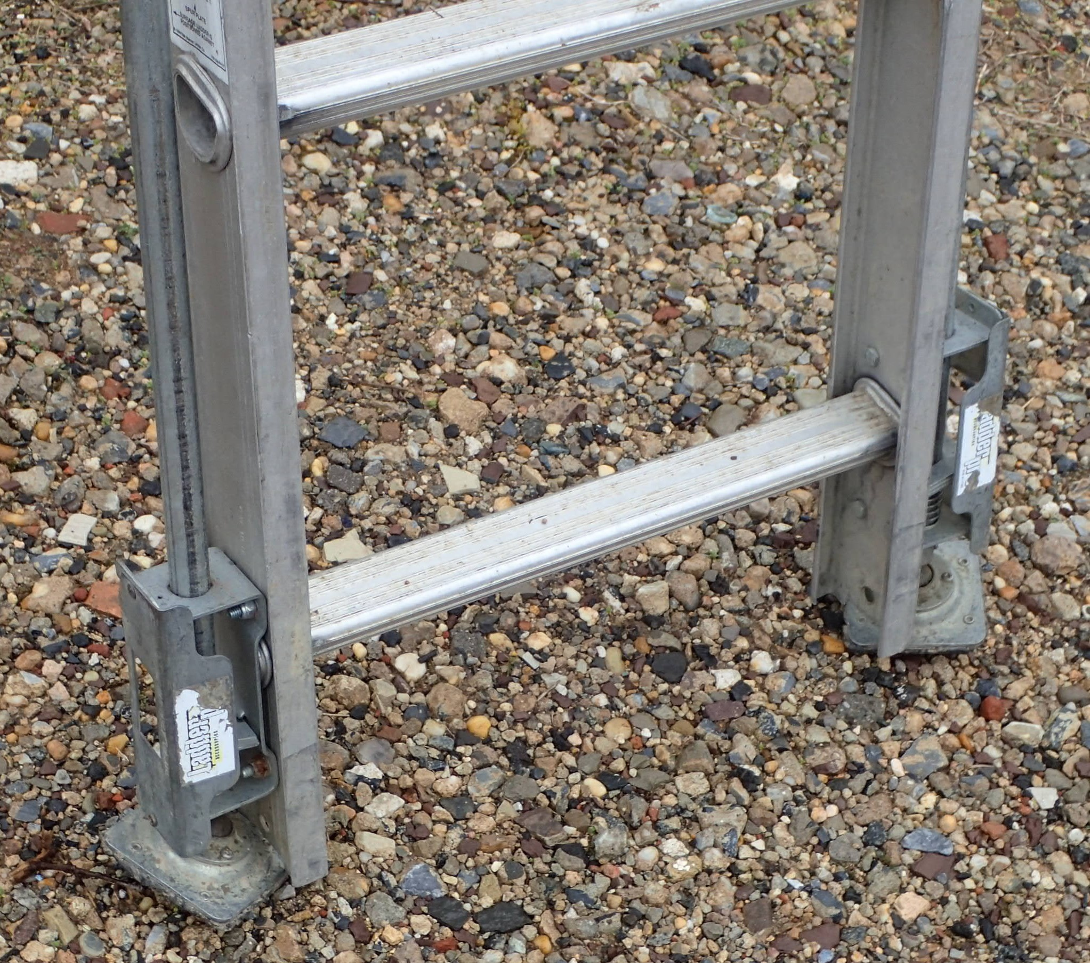
Ladder leveling feet are an important safety feature, particularly with boxes on utility poles. Only buy high quality feet, such as the Xtenda-Leg® Ladder Leveler, which cost between $80 and $100 but are well worth the price. Bolt them above and below a cross step, which may require cutting 4 inches off the bottom of the ladder.

Slide 15
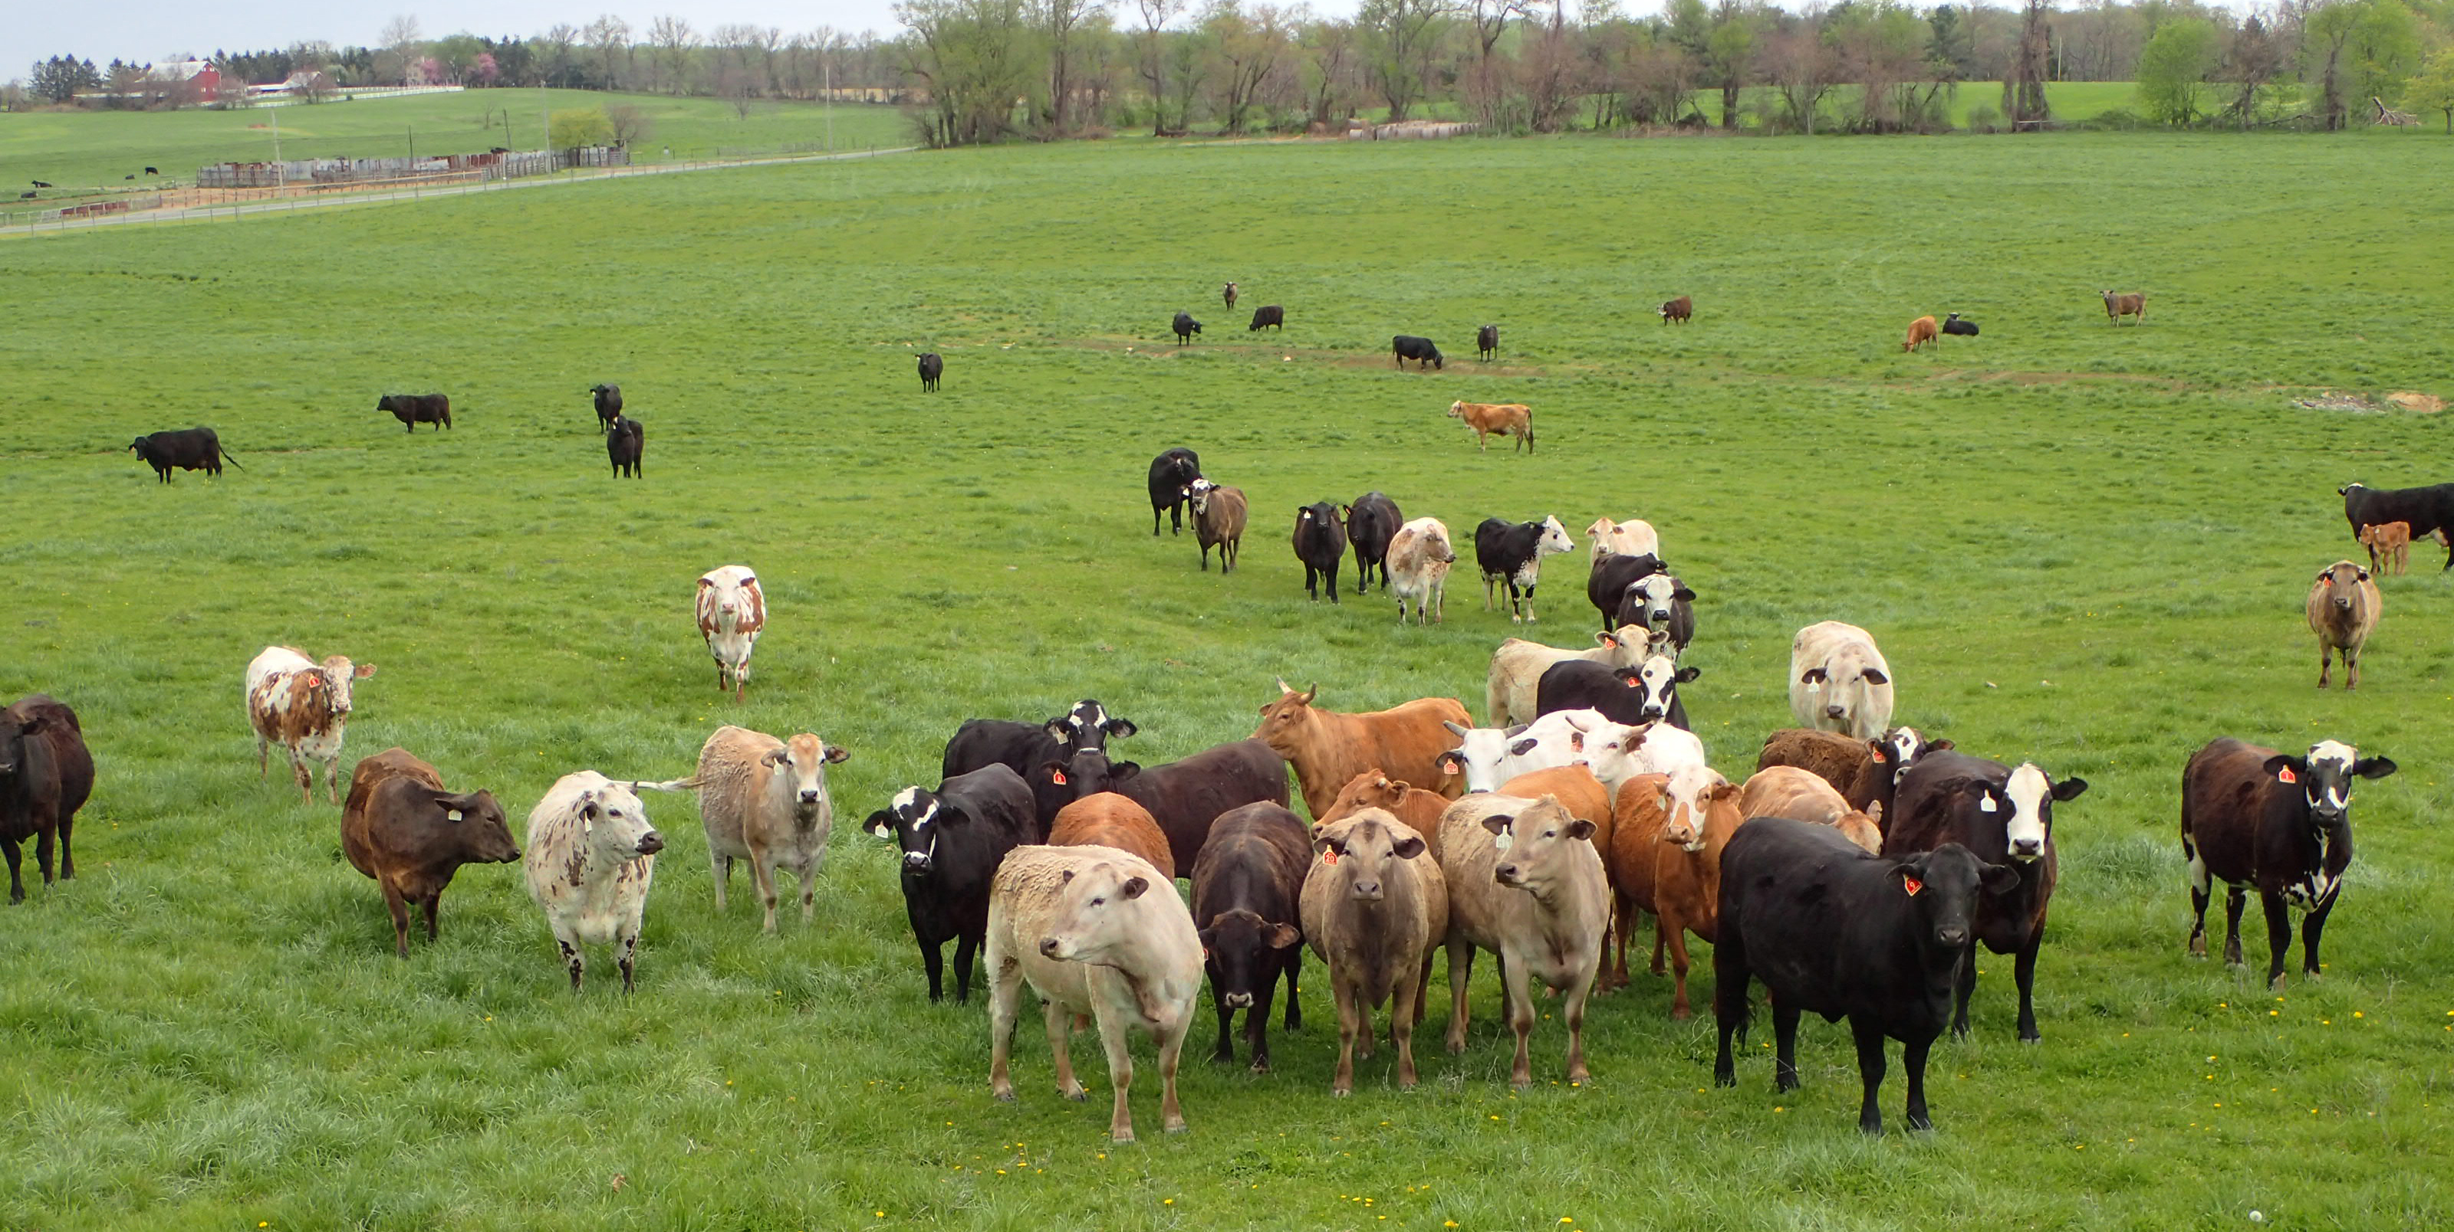
90% of our 350 nest boxes are on or adjacent to pasture habitat. As long as it isn’t overgrazed, pasture provides accessible food for kestrels. Livestock keep vegetation low, step on small rodent shallow tunnels, and deposit manure that fertilizes plants and attracts insects and other animals.

Slide 16
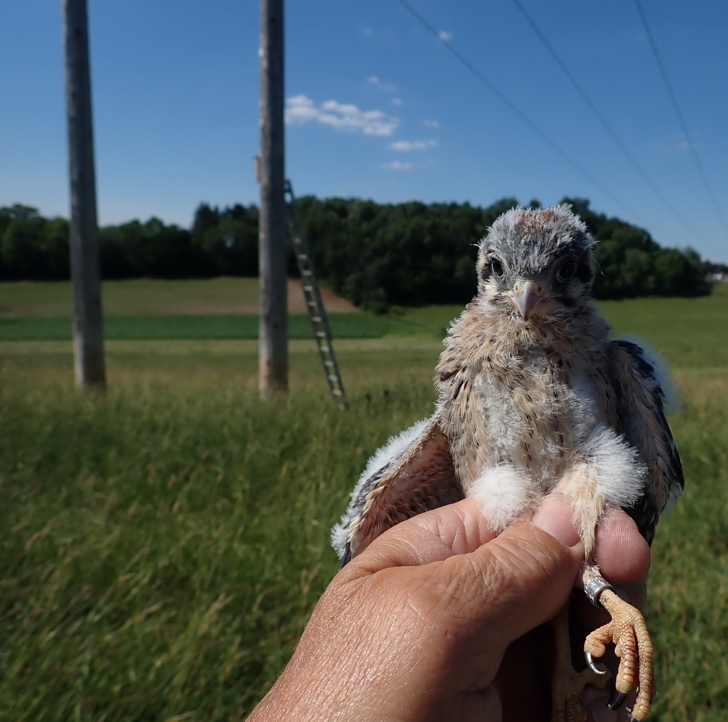
Utility pole mounted nest boxes within pastureland and along slow-speed farm access lanes are preferred to public roadway mounts due to less disturbance and less chance of kestrels – especially the young in their early flight attempts –
being hit by vehicles.

Slide 17
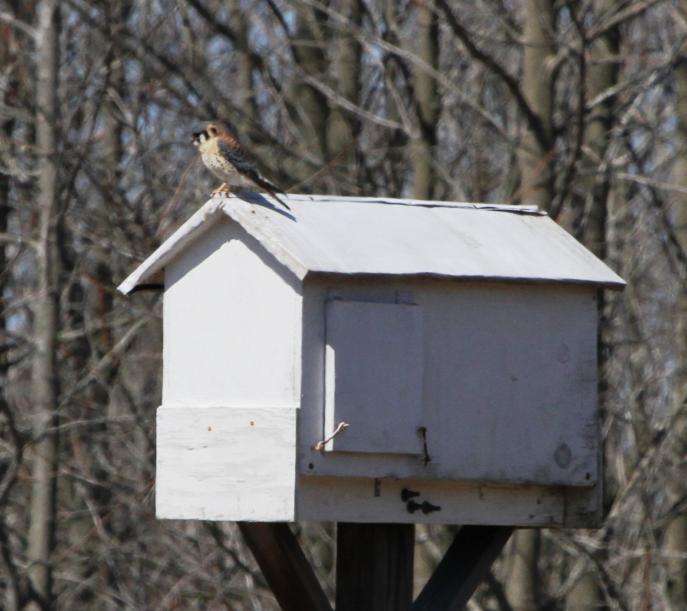
Kestrels occasionally nest in barn owl boxes like this one. At one farm we had a occupied kestrel box on a pasture utility pole and a barn owl box was then erected on a pole 100 yards away. The kestrels consistently chose the barn owl box over the smaller kestrel box, so we removed the kestrel box.

Slide 18
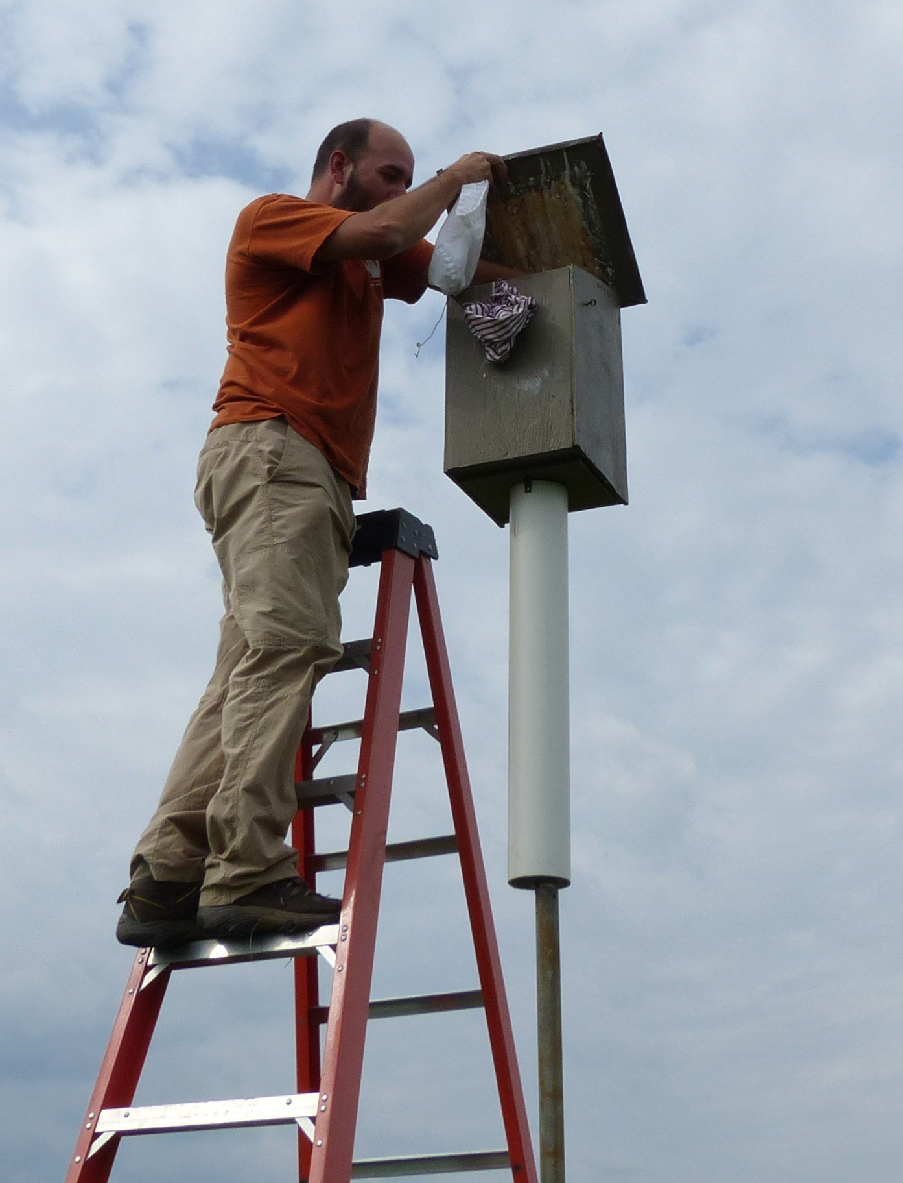
Top opening boxes are easier to build and lessen the chance that older nestlings and adults will escape from boxes when you reach in to band them. But they are harder and less safe to access since you need to be 2 or 3’ higher to reach inside. We no longer have any boxes that are top opening.
The plastic predator guard on this box is screwed to the box bottom, and doesn’t wobble. Most of our new guards are the wobbling kind that are mounted lower on the pipe.

Slide 19
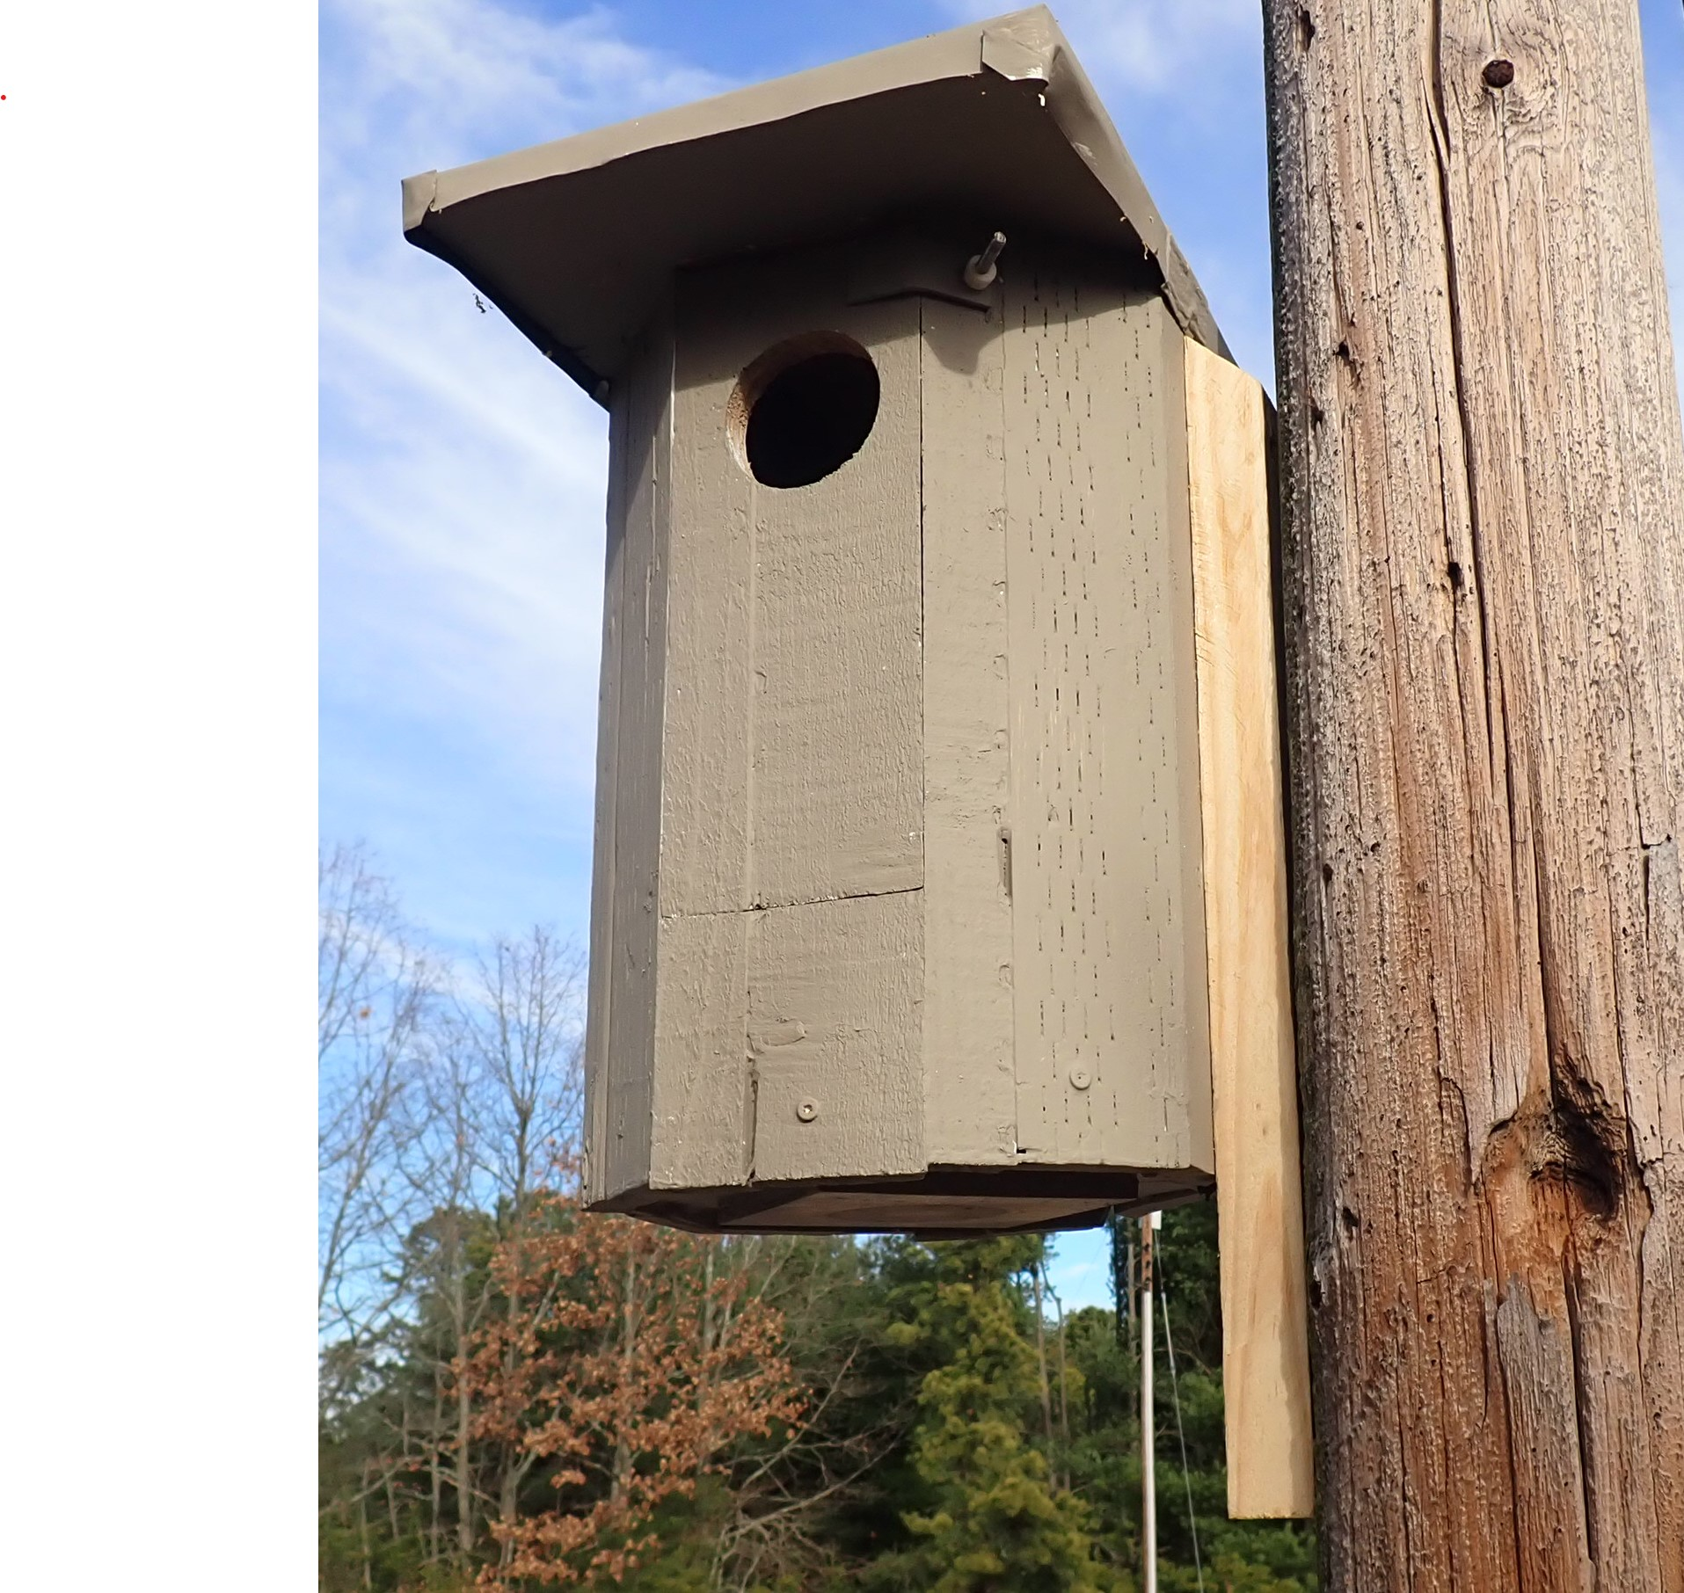
A lot of our current boxes are octagonal in shape. Although we like the appearance of these boxes, they are harder to build and it’s doubtful kestrels prefer them over 4-sided boxes. The tight fit of the access door does make them more resistant to rain intrusion.
This front opening box is more easily serviced by a left-handed person. Note how the side mount makes it easier to reach inside with ladders slanted in their recommended safest slant angle of 4 to 1: for every 4 feet up the ladder base should be 1 foot from the pole base. A 10 foot ladder should be 2.5 feet from the pole base and, of course, should also be strapped to the pole at the top.

Slide 20
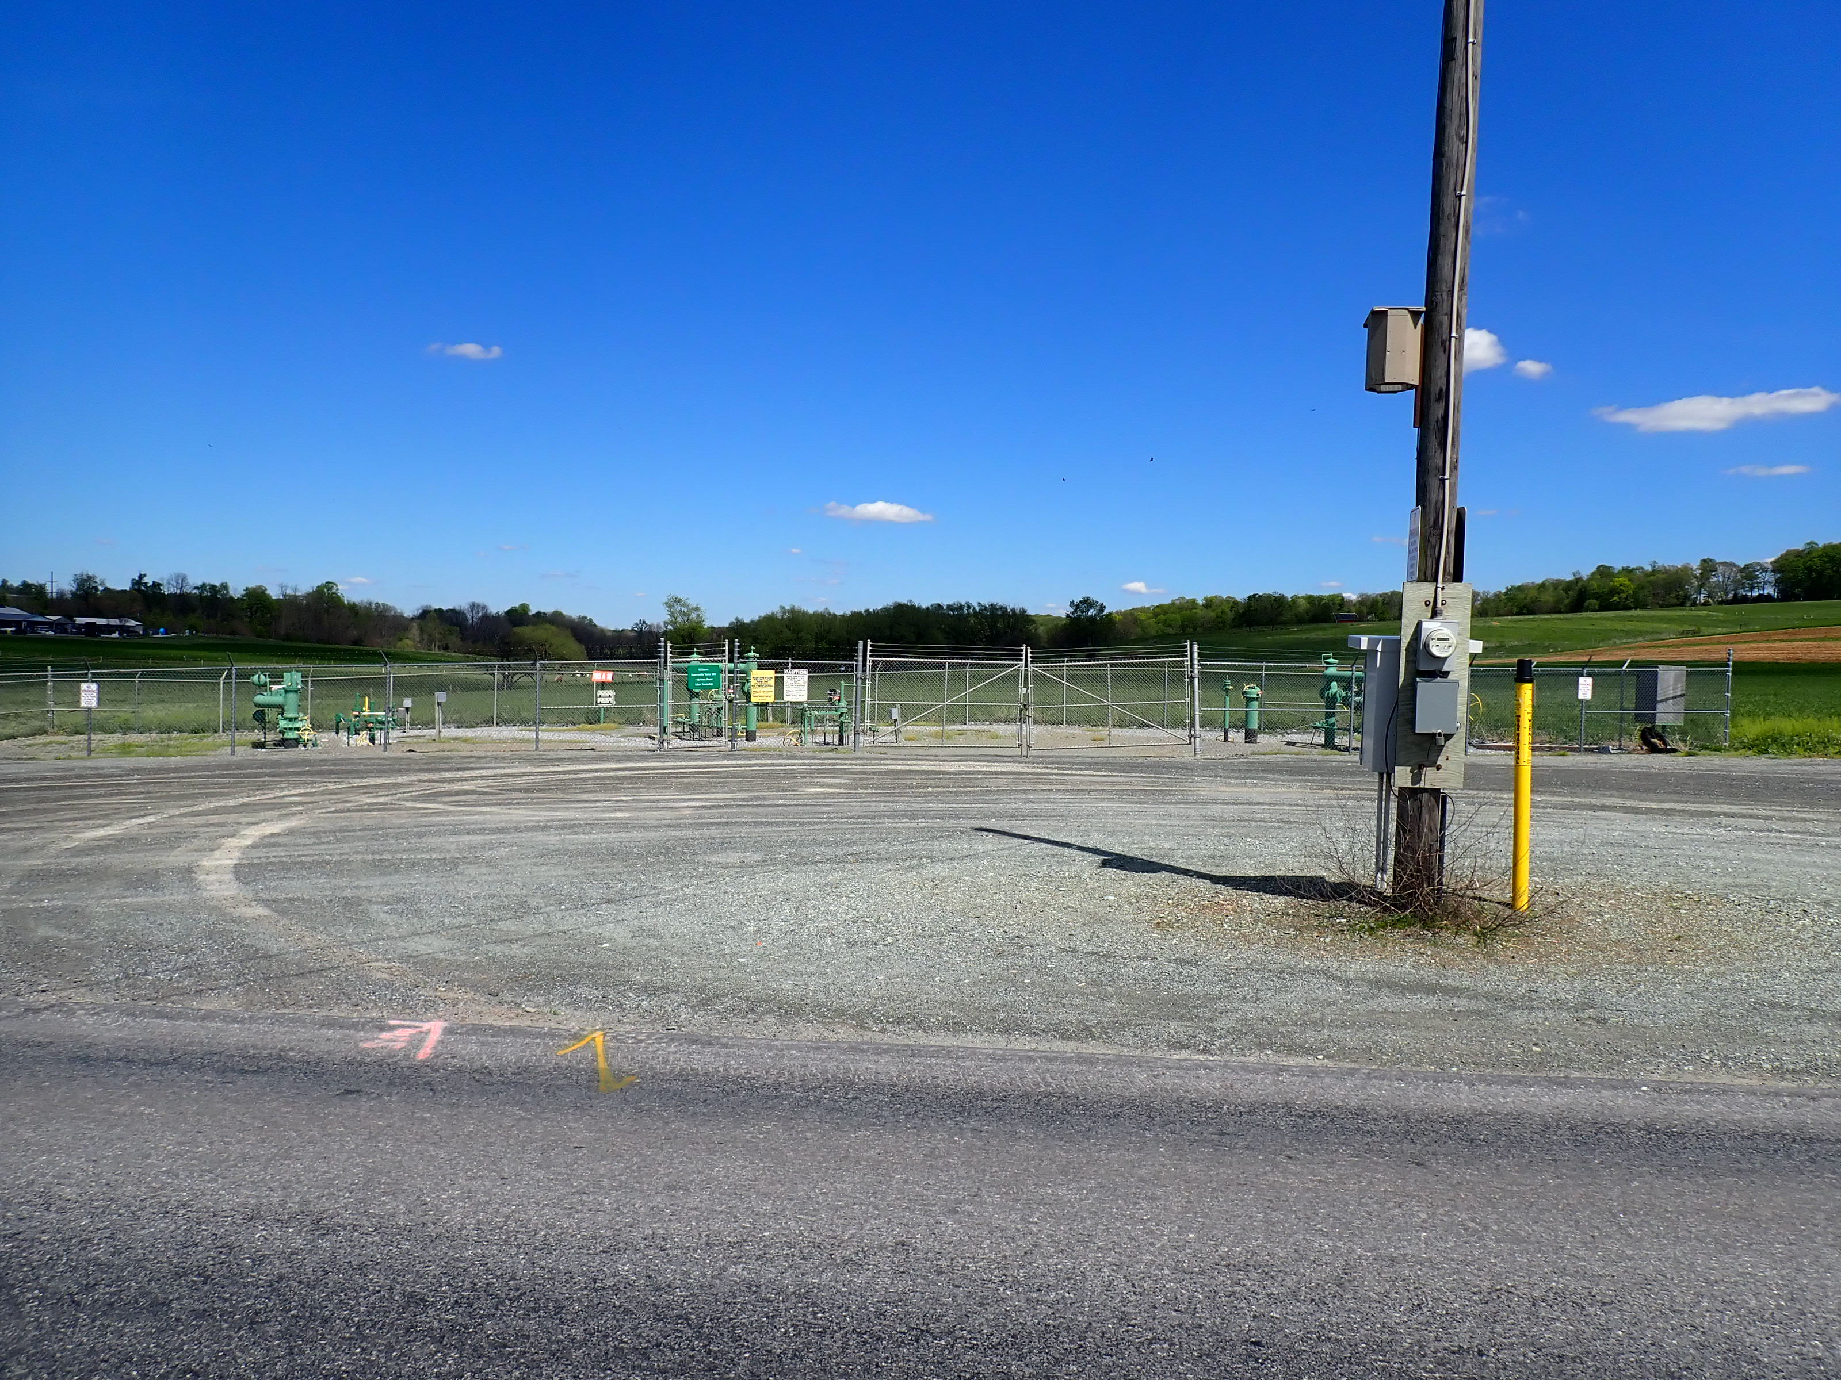
The box installed on this utility pole has successfully produced kestrels each of the first 3 years it has been up. It’s 10’ high along a country road in a gravel lot owned by a gas utility company with a fenced service area in the background. But it’s also surrounded by Amish pastureland.

Slide 21
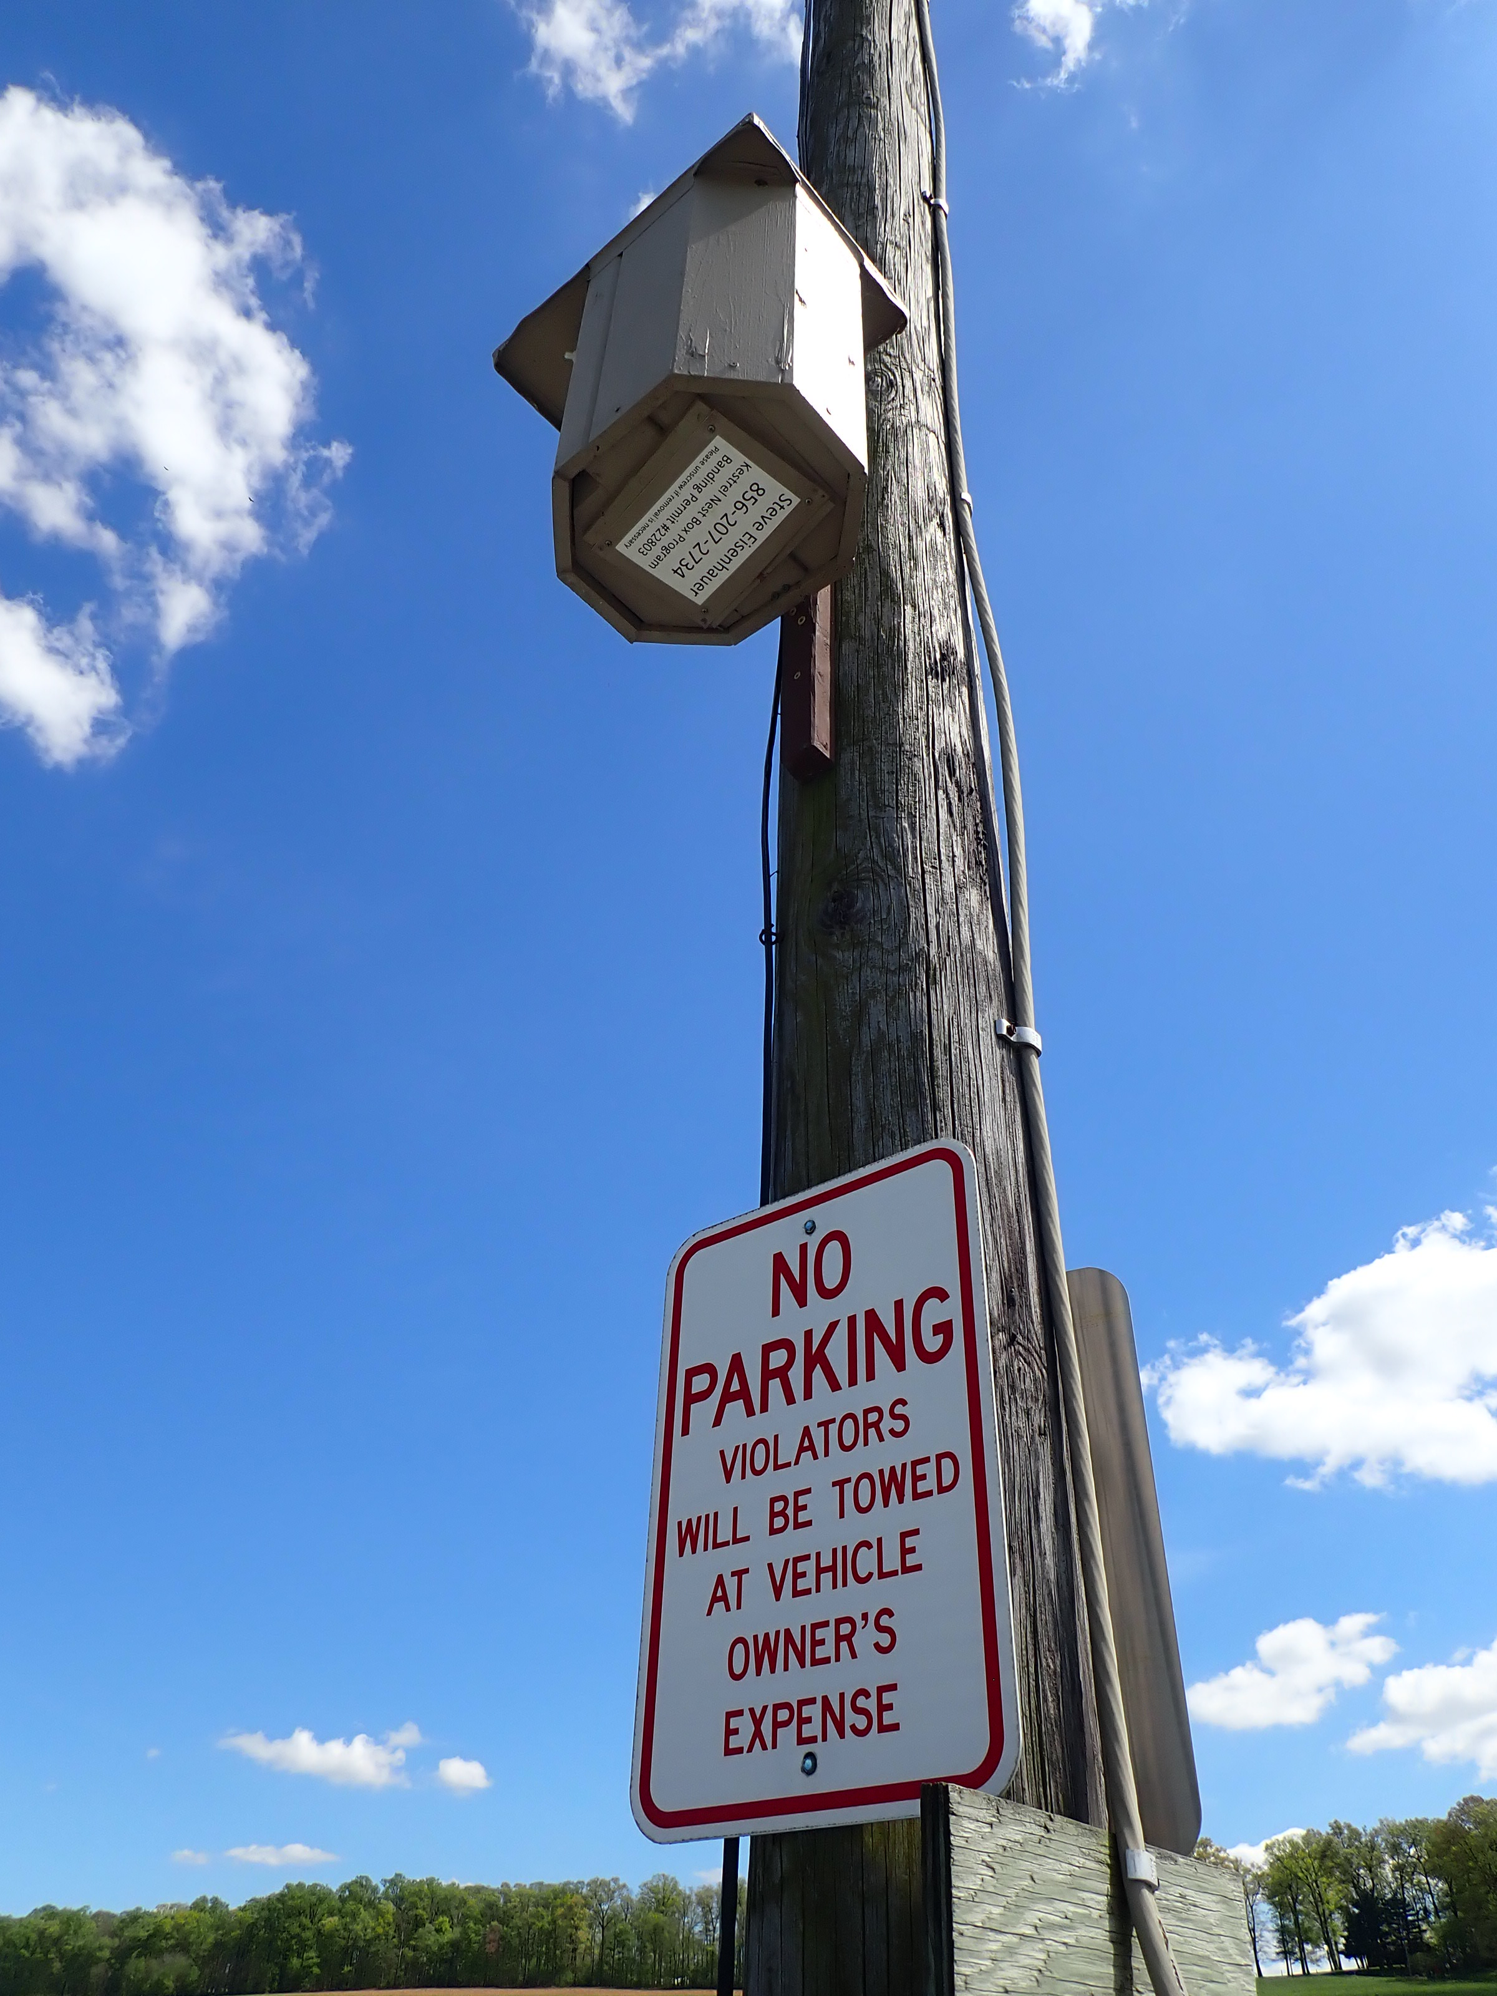
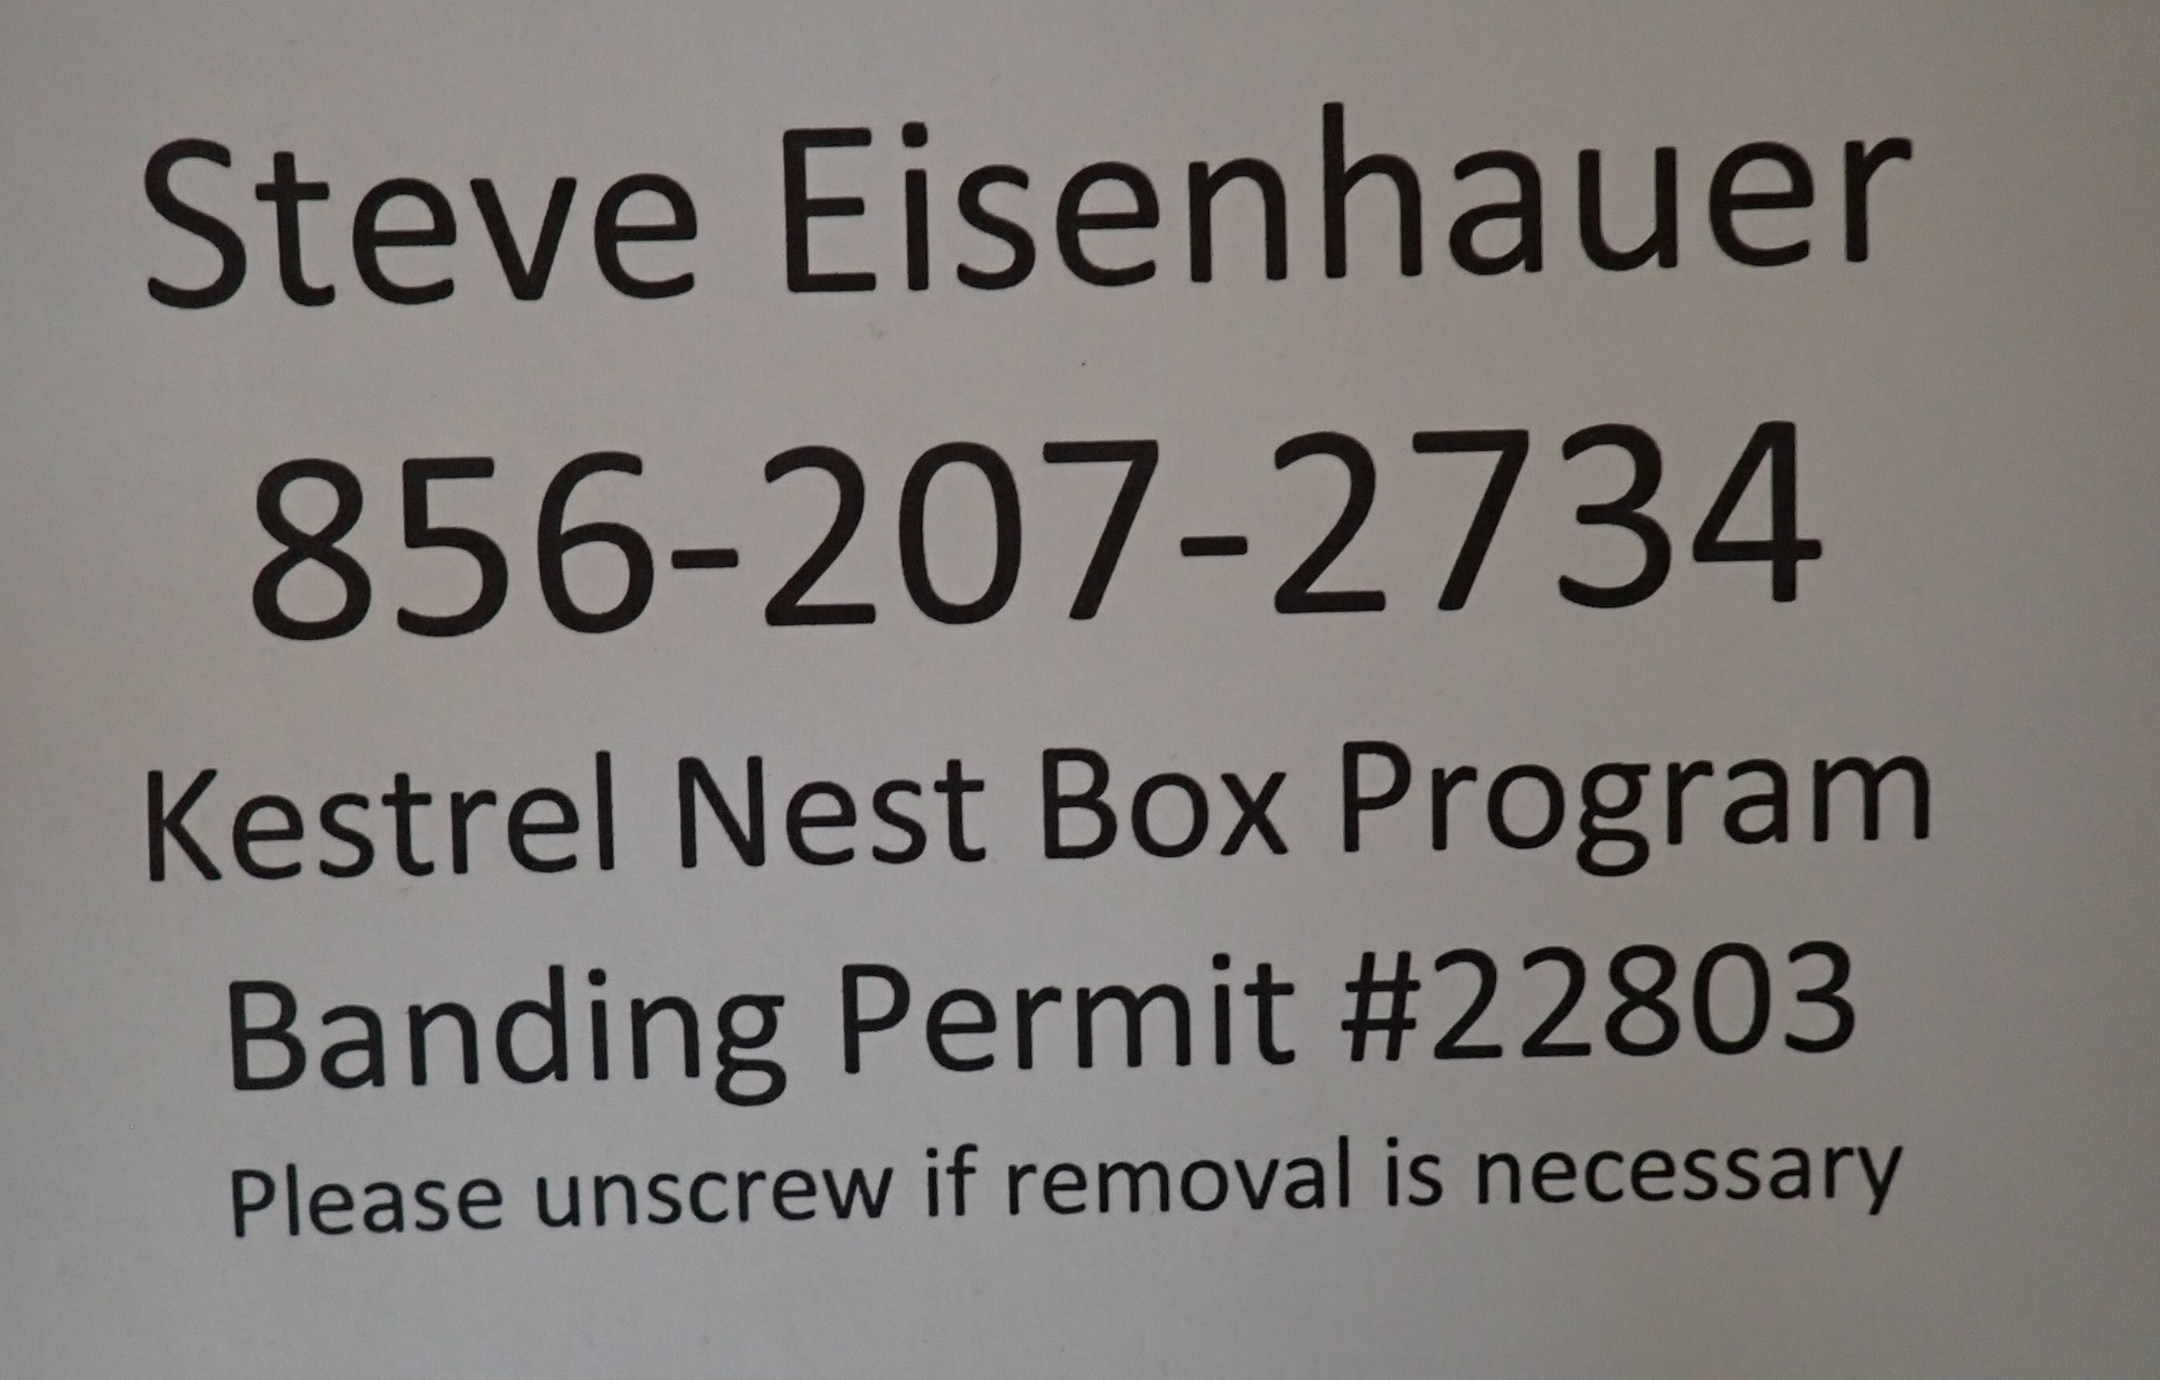
Since we were not able to secure permission from the utility company or the surrounding farmers, we installed this box with the below placard screwed on the bottom: weather-proofed with plastic laminate and clear silicone. Two of our 350 installed boxes were installed without landowner permission. Both have these bottom placards.

